Slide 1
SQL Day 2

Slide 2
Day | Topic | Chapter Details | Time Duration
Day 2 | Operators | Debugging errors | 60 mins
 |  | SQL style
 |  | Using WHERE with numbers
 |  | Using WHERE with text
 |  | Using AND and OR
 |  | Using BETWEEN
 |  | Filtering text
 |  | LIKE and NOT LIKE
 | 5 mins Break
 | Built-in functions | WHERE IN | 60 mins
 |  | Combining filtering and selecting
 |  | NULL values
 |  | What does NULL mean?
 |  | Aggregate functions and data types
 |  | Practice with aggregate functions
 |  | Summarizing subsets
 |  | Combining aggregate functions with WHERE
 |  | Using ROUND()
 |  | ROUND() with a negative parameter
 |  | Aliasing and arithmetic; functions

Slide 3
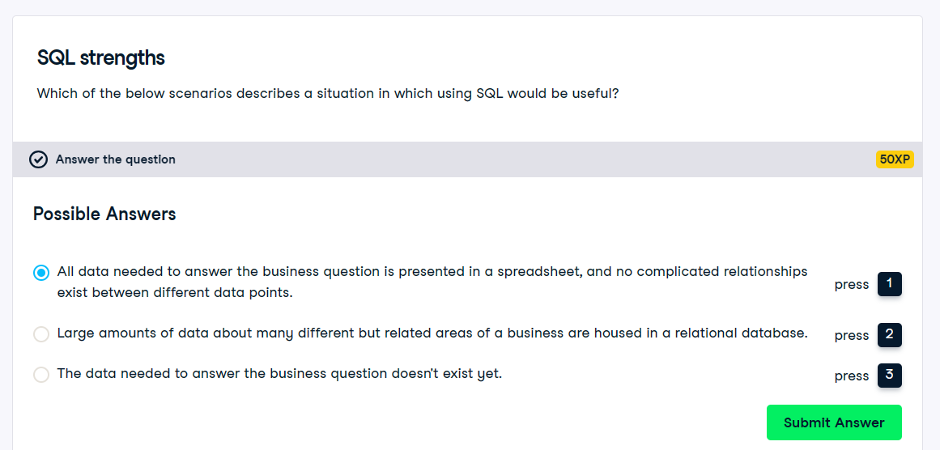

Slide 4
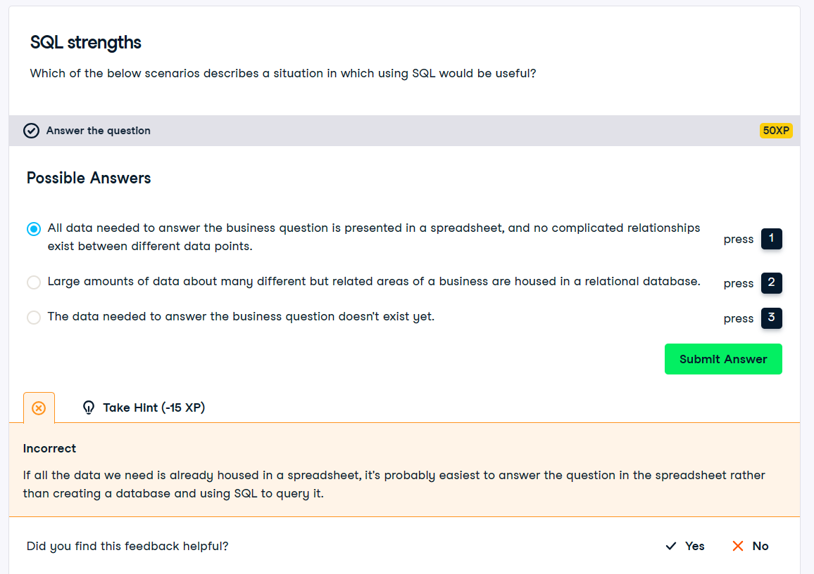

Slide 5
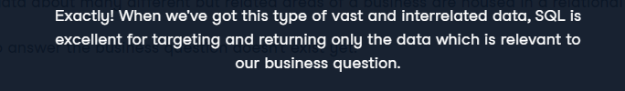
Ans | 2

Slide 6
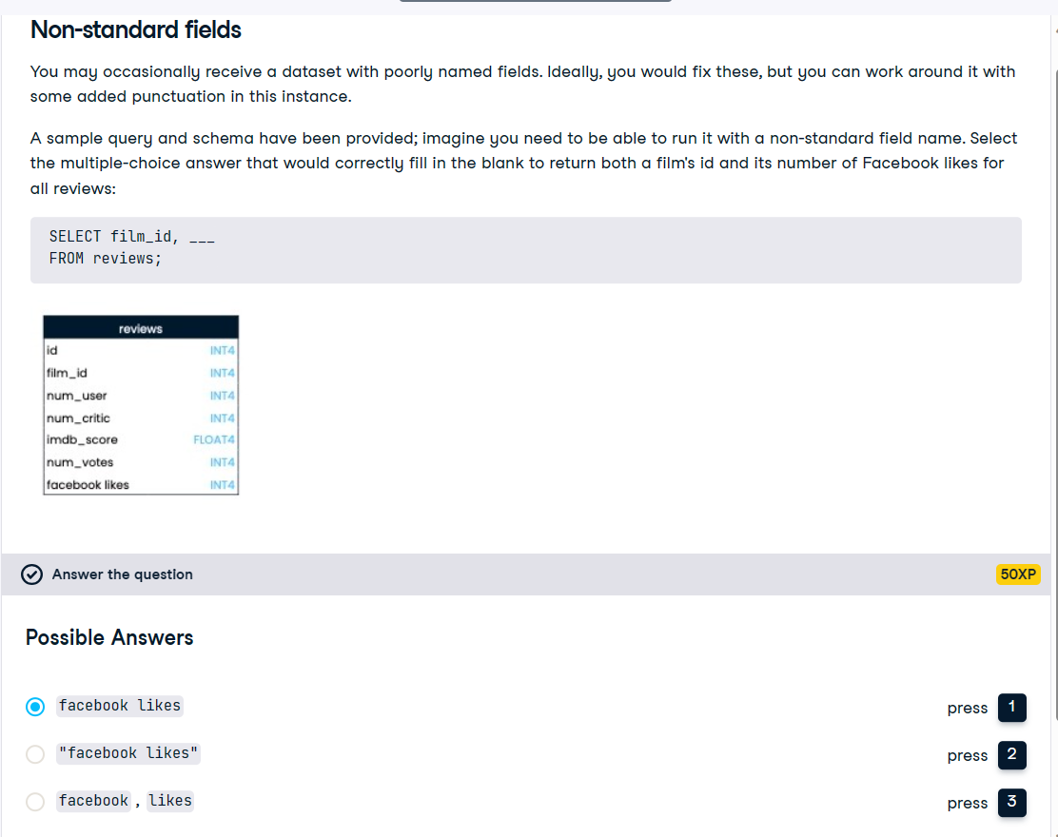

Slide 7

Ans | 2

Slide 9
Welcome to Basic SQL Commands

Slide 10
What is SQL statement.
Types of SQL statements and their use with examples

Slide 11
What is a SQL Statement and types of SQL statements

Slide 12
SQL statements defined…
SQL (pronounced "ess-que-el") stands for Structured Query Language
SQL is used to communicate with a database.
According to ANSI (American National Standards Institute), it is the standard language for relational database management systems.
SQL statements are used to perform tasks such as update data on a database, or retrieve data
from a database.
Most RDBMS use SQL .
Most of them also have their own additional proprietary extensions that are usually only used on their system.
However, the standard SQL commands such as "Select", "Insert", "Update", "Delete", "Create", and "Drop" can be used to accomplish almost everything that one needs to do with a database.

Slide 13
SQL statements examples…
USE AdventureWorks;
SELECT * FROM Sales.SalesOrderHeader
WHERE [OrderDate] BETWEEN ‘1/1/2021’ AND ‘4/31/2021’
USE AdventureWorks;
update Sales.SalesOrderHeader set OrderDate = getdate() WHERE [OrderDate] = ‘1/1/2021’
USE AdventureWorks;
drop table Sales.SalesOrderHeader

Slide 14
Types of SQL Statements…
DML (DATA MANIPULATION LANGUAGE)
DDL (DATA DEFINITION LANGUAGE)
DCL (DATA CONTROL LANGUAGE)
TCL (TRANSACTION CONTROL LANGUAGE)

Slide 15
DML Statements with examples

Slide 16
DML statements defined…
DML is short name of Data Manipulation Language.
Deals with data manipulation, and includes most common SQL
statements such SELECT, INSERT, UPDATE, DELETE etc.
It is used to store, modify, retrieve, delete and update data in database.

Slide 17
SELECT statements…
The SELECT statement is used to select records from the table, with or without a condition.
Select * from student - Gets all records of student table.
Select * from student where rank > 5 - Gets records with the condition where students' rank is greater than 5.

Slide 18
Insert statements…
INSERT statement is used to insert a set of values into a database table. Insert statement it used with Values.
Insert Into Student (Rank, StudentName, Mark) Values (1,’Abbas’,450)

Slide 19
Update statements…
The UPDATE statement is used to update existing values in a table, which is based on some condition.
update student set StudentName=’Abbas’ where StudentName=’Imran’
The query given above will update the student Name from Imran to Abbas.

Slide 20
Delete statements…
Delete statement is used to delete the existing record in the table, which is based on some condition.
Delete from Student where StudentName=’Abbas’
The query given above will delete records which has StudentName as Abbas.

Slide 21
DDL Statements with examples

Slide 22
DDL statements defined…
DDL is short name of Data Definition Language.
Which deals with database schemas and descriptions.
How the data should reside in the database.
CREATE, ALTER , DROP, TRUNCATE.

Slide 23
CREATE statements…
CREATE statement is used to create a new table in an existing database. CREATE statement is also used to create other database object such as a stored procedure, function, etc.
Create Table Student (Rank Int,StudentName varchar(50),Mark Float)

Slide 24
Alter statements…
Alter statement can add a column, modify a column, drop a column, rename a column or rename a table.
Alter Table Student Add (StudentAddress varchar (100))

Slide 25
DROP statements…
SQL DROP TABLE statement is used to remove a table definition and all the data, indexes, triggers, constraints and permission specifications for the table.
Drop table student
Drop database AdventureWorks

Slide 26
Truncate statements…
TRUNCATE SQL query removes all rows from a table, without logging the individual row deletions.
Truncate Table Table_Name

Slide 27
DCL Statements with examples

Slide 28
DCL statements defined…
DCL is short name of Data Control Language.
It defines the control over the data in the database.
GRANT , REVOKE.

Slide 29
GRANT statements…
GRANT statement used to grant SQL SELECT, UPDATE, INSERT, DELETE, and other privileges on tables or views.
GRANT UPDATE ON ORDER_BACKLOG TO JONES WITH GRANT OPTION
GRANT SELECT ON TABLE Q.STAFF TO PUBLIC

Slide 30
REVOKE statements…
REVOKE is used to cancel previously granted or denied permissions.
REVOKE DELETE ON employees FROM anderson;
REVOKE ALL ON employees FROM anderson;

Slide 31
TCL Statements with examples

Slide 32
TCL statements defined…
TCL is short name of Transactions Control Language.
These commands are used to manage the transactions in the
database.
Used to manage the changes made by DML statements.
It also allows the statements to be grouped together into logical
transactions.

Slide 33
COMMIT statements…
Commit command is used to permanently save any transaction into the database.
When we use Commit in any query then the change made by that query will be permanent and visible.
begin tran d
update emp set empName ='D' where empid=11
commit tran d

Slide 34
ROLLBACK statements…
Rollback is used to undo the changes made by any command but only before a commit is done.
We can't Rollback data which has been committed in the database with the help of the commit keyword.
DECLARE @BookCount int BEGIN TRANSACTION AddBook
INSERT INTO Books VALUES (20, 'Book15', 'Cat5', 2000)
SELECT @BookCount = COUNT(*) FROM Books WHERE name = 'Book15' IF @BookCount > 1
BEGIN
ROLLBACK TRANSACTION AddBook
PRINT 'A book with the same name already exists‘ END
ELSE BEGIN
COMMIT TRANSACTION AddStudent
PRINT 'New book added successfully‘ END

Slide 35
SAVEPOINT statements…
SAVEPOINT command is used to temporarily save a transaction so that you can roll back to that point whenever necessary.
Savepoint names must be distinct within a given transaction.
After a savepoint has been created, you can either continue processing, commit your work, roll back the entire transaction, or roll back to the savepoint.
UPDATE employees SET salary = 7000 WHERE last_name = 'Banda'; SAVEPOINT banda_sal;
UPDATE employees SET salary = 12000 WHERE last_name = 'Greene'; SAVEPOINT greene_sal;
SELECT SUM(salary) FROM employees;
ROLLBACK TO SAVEPOINT banda_sal;
UPDATE employees SET salary = 11000 COMMIT;
WHERE last_name = 'Greene';

Slide 36
Welcome to Query and Manipulation of Data

Slide 37
SELECT Statement.
Expressions, Conditions, and Operators.
WHERE Clause, ORDER BY Clause , GROUP BY Clause.
Select from two or more tables - JOINS.
Different Types of JOINS.
What is subquery and how to design and use subquery.
INSERT Statement in detail.
UPDATE Statement in detail.
DELETE Statement in detail.
Difference between DELETE and Truncate Statement

Slide 38
Create TABLE(s) and Temp Table(s)

Slide 39
What is Table ?
Tables are database objects that contain all the data in a database. .
In tables, data is logically organized in a row-and-column format.
Each row represents a unique record.
Each column represents a field in the record.
With up to 1024 columns in each table.

Slide 40
CREATE TABLE Statement
CREATE TABLE [database_name.][schema_name.]table_name ( pk_column data_type PRIMARY KEY,
column_1 data_type NOT NULL, column_2 data_type,
...,
table_constraints );
Specify the name of the database in which the table is created.
Specify the schema to which the new table belongs.
Specify the name of the new table.
Each table should have a primary key which consists of one or more columns. Typically, you list the primary key columns first and then other
columns.
If the primary key contains only one column, you can use the PRIMARY KEY keywords after the column name. If the primary key consists of two or more columns, you need to specify the PRIMARY KEY constraint as a table constraint.
Each column has an associated data type specified after its name in the statement.
A column may have one or more column constraints such as NOT NULL and UNIQUE.
A table may have some constraints specified in the table constraints section such as FOREIGN KEY, PRIMARY KEY, UNIQUE and CHECK.

Slide 41
CREATE table example
CREATE TABLE sales.visits (
visit_id INT PRIMARY KEY IDENTITY (1, 1),
first_name VARCHAR (50) NOT NULL, last_name VARCHAR (50) NOT NULL, visited_at DATETIME, phone VARCHAR(20), store_id INT NOT NULL,
FOREIGN KEY (store_id) REFERENCES sales.stores (store_id) );

Slide 42
What is Temporary (temp) Table
A temporary table in SQL Server, as the name suggests, is a database table that exists temporarily on the database server.
A temporary table stores a subset of data from a normal table for a certain period of time.
Temporary tables are particularly useful when you have a large number of records in a table and you repeatedly need
to interact with a small subset of those records.
In such cases instead of filtering the data again and again to fetch the subset, you can filter the data once and store it in a temporary table.
Temporary tables are stored inside “tempdb” which is a system database.

Slide 43
Create Temporary (temp) Table
The name of a temporary table must start with a hash (#).
Method 1.select BusinessEntityID,firstname,lastname into #TempPersonTable
from [Person].[Person] where title = 'mr. ‘
Method 2. Create table #TempPersonTable (
BusinessEntityID int, Firstname nvarchar(50), lastname nvarchar(50) ) INSERT INTO #TempPersonTable
SELECT BusinessEntityID,FirstName,LastName
from [Person].[Person]
where title = 'mr.'

Slide 44
What is a View ?

Slide 45
What is a View ?
A VIEW in SQL Server is like a virtual table that contains data from one or multiple tables.
It does not hold any data and does not exist physically in the database.
Similar to a SQL table, the view name should be unique in a database.
It contains a set of predefined SQL queries to fetch data from the database..
It can contain database tables from single or multiple databases as well.
A VIEW does not require any storage in a database because it does not exist physically.

Slide 46
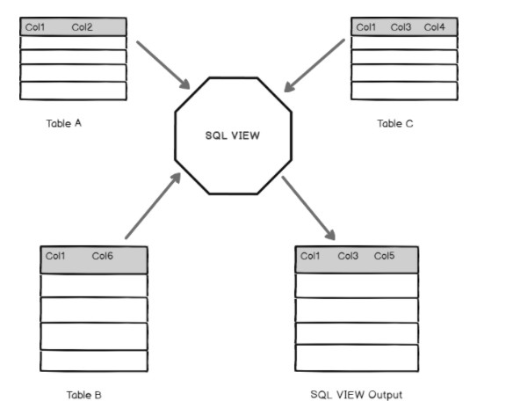
View definition contd..

Slide 47
How to create a View
CREATE VIEW Name AS
Select column1, Column2...Column N From tables
Where conditions;
CREATE VIEW EmployeeRecords
AS
SELECT
Person.Person.Title, Person.Person.FirstName, Person.Person.LastName,
Person.PersonPhone.PhoneNumber, Person.PhoneNumberType.Name
FROM
Person.Person INNER JOIN
Person.PersonPhone ON Person.Person.BusinessEntityID = Person.PersonPhone.BusinessEntityID INNER JOIN
Person.PhoneNumberType ON Person.PersonPhone.PhoneNumberTypeID = Person.PhoneNumberType.PhoneNumber
TypeID
WHERE
(Person.Person.Title = N'Mr.')

Slide 48
SELECT Statement in detail

Slide 49
SELECT expressions
From table_name
[WHERE clause] [GROUP BY clause] [HAVING clause] [ORDER BY clause]
*code in brackets is optional
*words in bold letters are key words or reserved words

Slide 50
Specify Columns Name
SELECT coulmn1,column2 ,,,,,,columnN
From table_name;
List All Columns using *
SELECT *
From table_name;
Column Order does not matter
SELECT column3, column1, column6
From table_name;

Slide 51
Operators, Expressions and Conditions

Slide 52
SQL Operators
The symbols which are used to perform logical and mathematical operations in SQL are called SQL operators.
There are three types of Operators used in SQL.
Arithmetic operators.
Relational operators.
Logical operators.

Slide 53
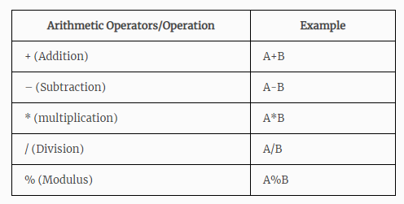
Arithmetic Operators
Arithmetic operators in SQL are used to perform mathematical calculations like addition, subtraction, multiplication, division and modulus in SQL statements.

Slide 54
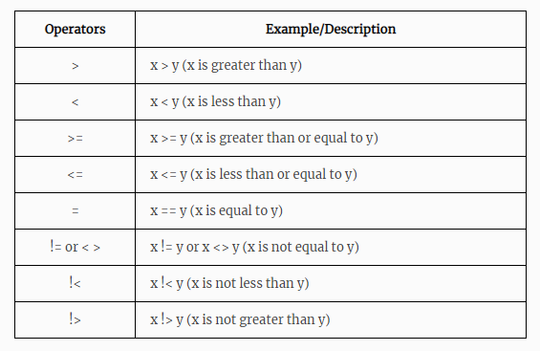
Relational Operators
Relational operators in SQL are used to find the relation between two columns. i.e. to compare the values of two columns in SQL statements.

Slide 55
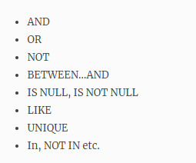
Logical Operators
Logical operators in SQL are used to perform logical operations on the given expressions in SQL statements.

Slide 56
Expressions
An expression is a combination of one or more values, operators and SQL functions that evaluate to a value.
These SQL EXPRESSIONs are like formulae and they are written in query language.
You can also use them to query the database for a specific set of data.
SELECT column1, column2, columnN FROM table_name WHERE [EXPRESSION | CONDITION|];

Slide 57
Types of Expressions
SQL Boolean expressions fetch data based on one-to-one matching. In other words, we can think of it as a query
that fetches one result at a time.
Find out employees whose age is equal to 26.
Query: SELECT * FROM dataflair_employee WHERE age = 26 ;
SQL Numerical expressions are used to perform mathematical operations on the stored data.
Find employees whose age, if doubled, will be more than 50. Query: SELECT * FROM dataflair_employee WHERE age*2 > 50 ;
SQL Date expressions are used to compare and get data according to various date-related queries and conditions.
Find the employees who were born after 1995 January.
Query: SELECT * FROM dataflair_employee WHERE DoB > DATE(‘1995/01/01’) ;

Slide 58
Conditions
A condition specifies a combination of one or more expressions and logical (Boolean) operators and returns a value
of TRUE, FALSE, or unknown.
SELECT *
FROM suppliers
WHERE (state = 'California' AND supplier_id <> 900)
OR (supplier_id = 100);

Slide 59
WHERE Clause, ORDER BY Clause, GROUP BY Clause, HAVING Clause

Slide 60
WHERE Clause
WHERE clause is used to specify a condition while fetching the data from a single table or by joining with multiple tables.
If the given condition is satisfied, then only it returns a specific value from the table.
We use the WHERE clause to filter the records and fetching only the necessary records.
The WHERE clause is not only used in the SELECT statement, but it is also used in the UPDATE, DELETE
statement, etc.
SELECT column1, column2, columnN FROM table_name
WHERE [condition]

Slide 61
ORDER BY Clause
ORDER BY clause is used to sort the data in ascending or descending order, based on one or more columns.
Some databases sort the query results in an ascending order by default.
SELECT column-list
FROM table_name [WHERE condition]
[ORDER BY column1, column2, .. columnN] [ASC | DESC];

Slide 62
GROUP BY Clause
GROUP BY clause is used in collaboration with the SELECT statement to arrange identical data into groups.
like "find the number of customers in each country".
Often used with aggregate functions (COUNT(), MAX(), MIN(), SUM(), AVG()) to group the result-set by one or more columns.
GROUP BY clause follows the WHERE clause in a SELECT statement and precedes the ORDER BY clause
SELECT column1, column2
FROM table_name WHERE [ conditions ]
GROUP BY column1, column2 ORDER BY column1, column2

Slide 63
HAVING Clause
HAVING Clause enables you to specify conditions that filter which group results appear in the results.
The WHERE clause places conditions on the selected columns.
Whereas the HAVING clause places conditions on groups created by the GROUP BY clause.
The HAVING clause must follow the GROUP BY clause in a query and must also precede the ORDER BY clause if used.
SELECT column1, column2
FROM table1, table2 WHERE [ conditions ]
GROUP BY column1, column2 HAVING [ conditions ]
ORDER BY column1, column2

Slide 64


Slide 65
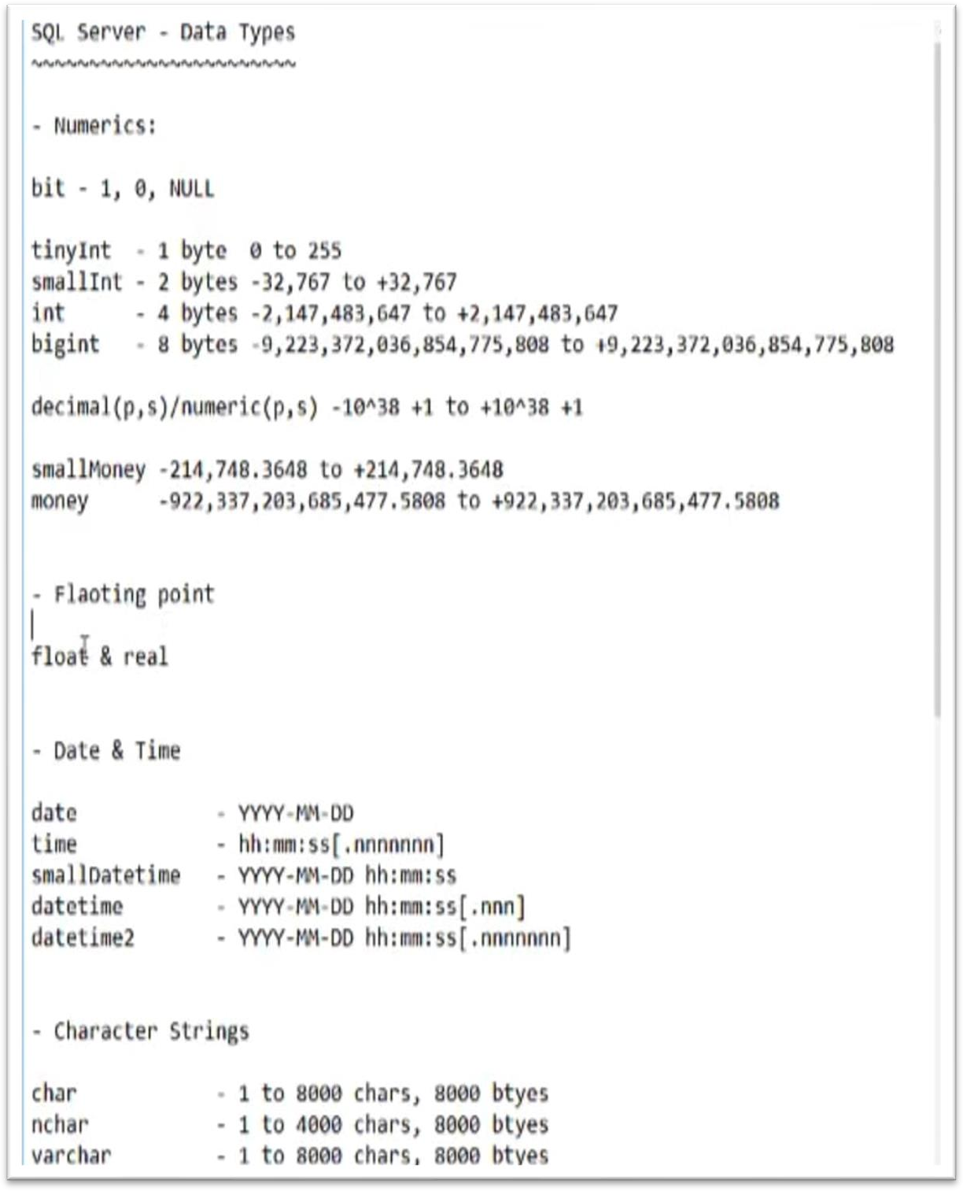

Slide 66
Recap:
DECLARE @VAR DECIMAL(6,2)
SET @VAR=100.55
SELECT @var
DECLARE @b char(5);
SET @b='SQL';
SELECT @b
DECLARE @a int; SET @a=2; SELECT @a

Slide 67


Slide 68
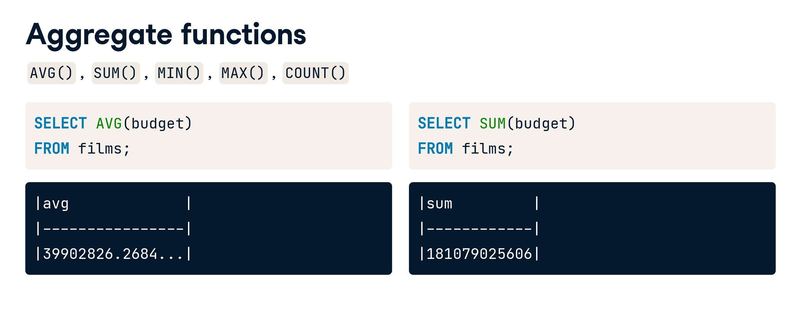

Slide 69
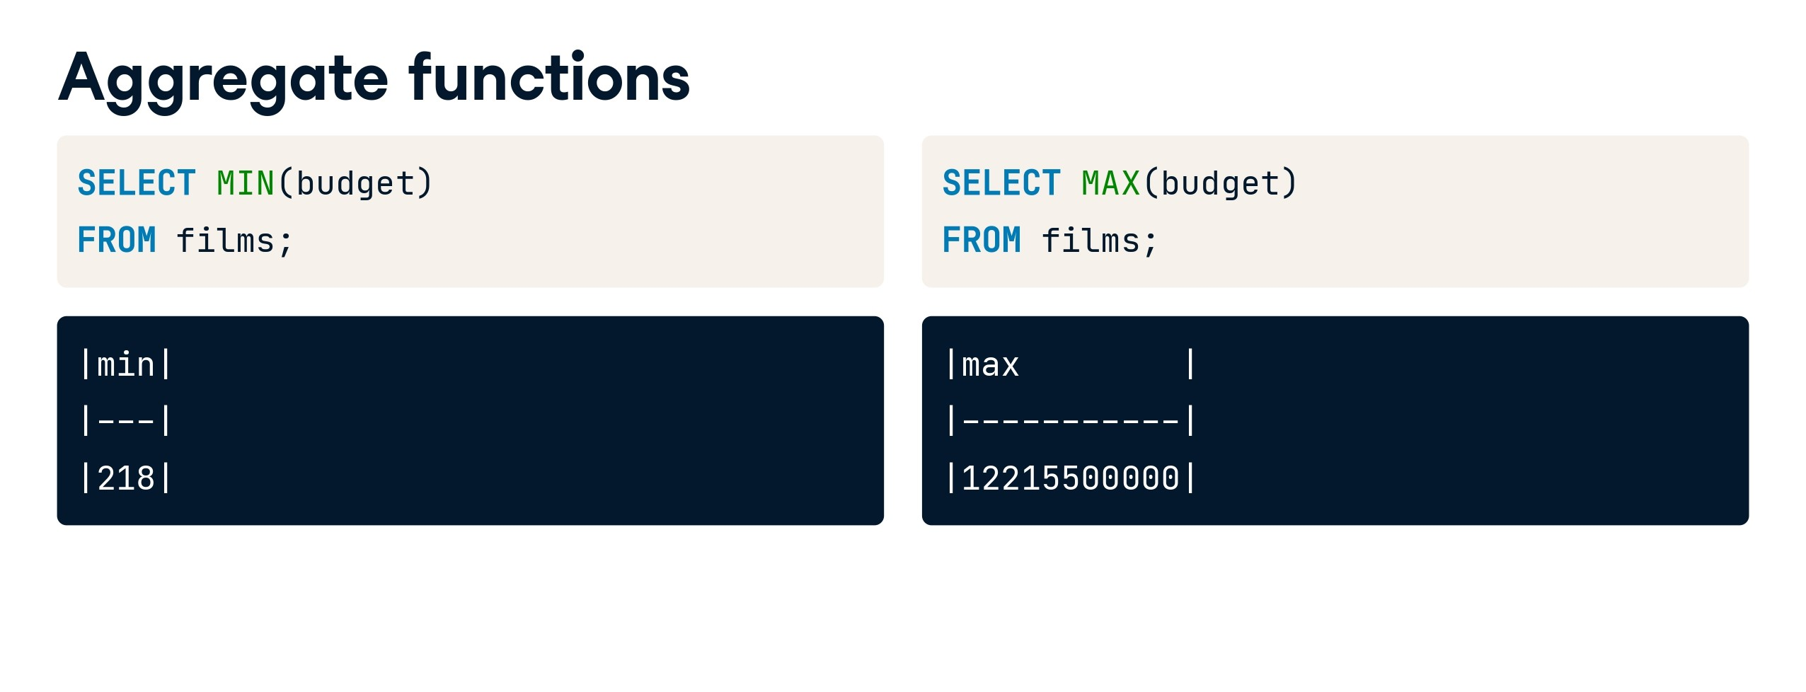

Slide 70
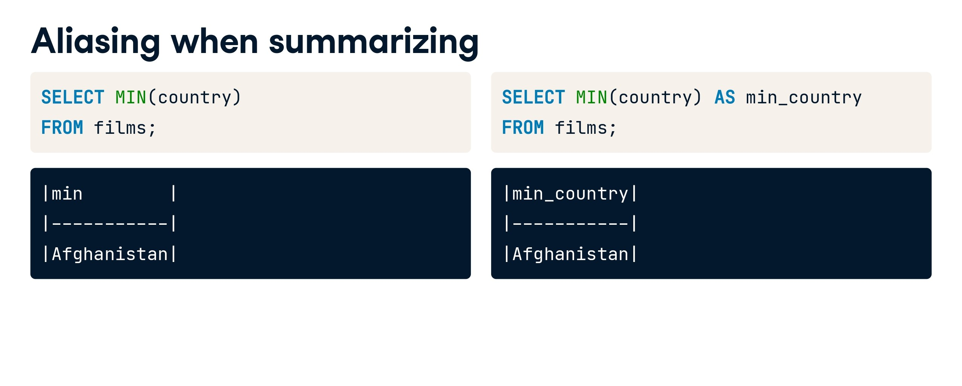

Slide 71


Slide 72
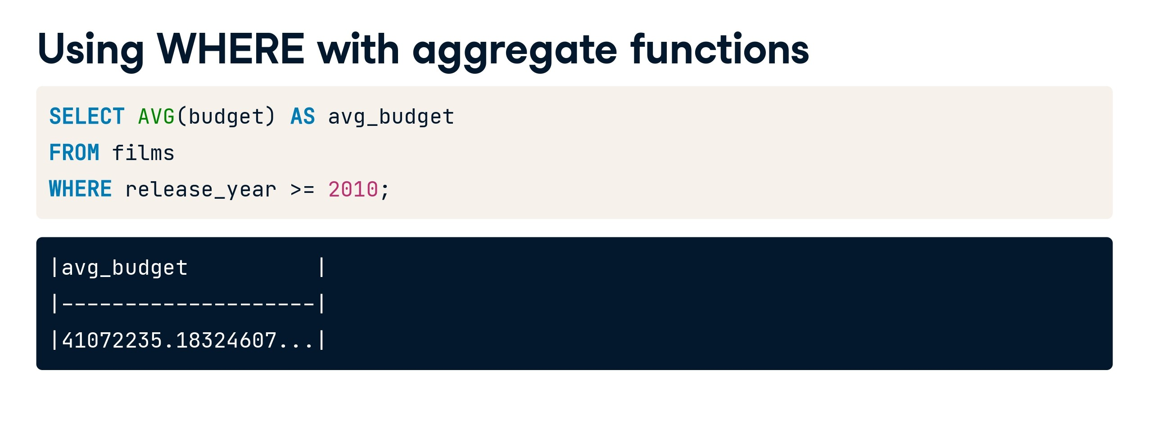

Slide 73
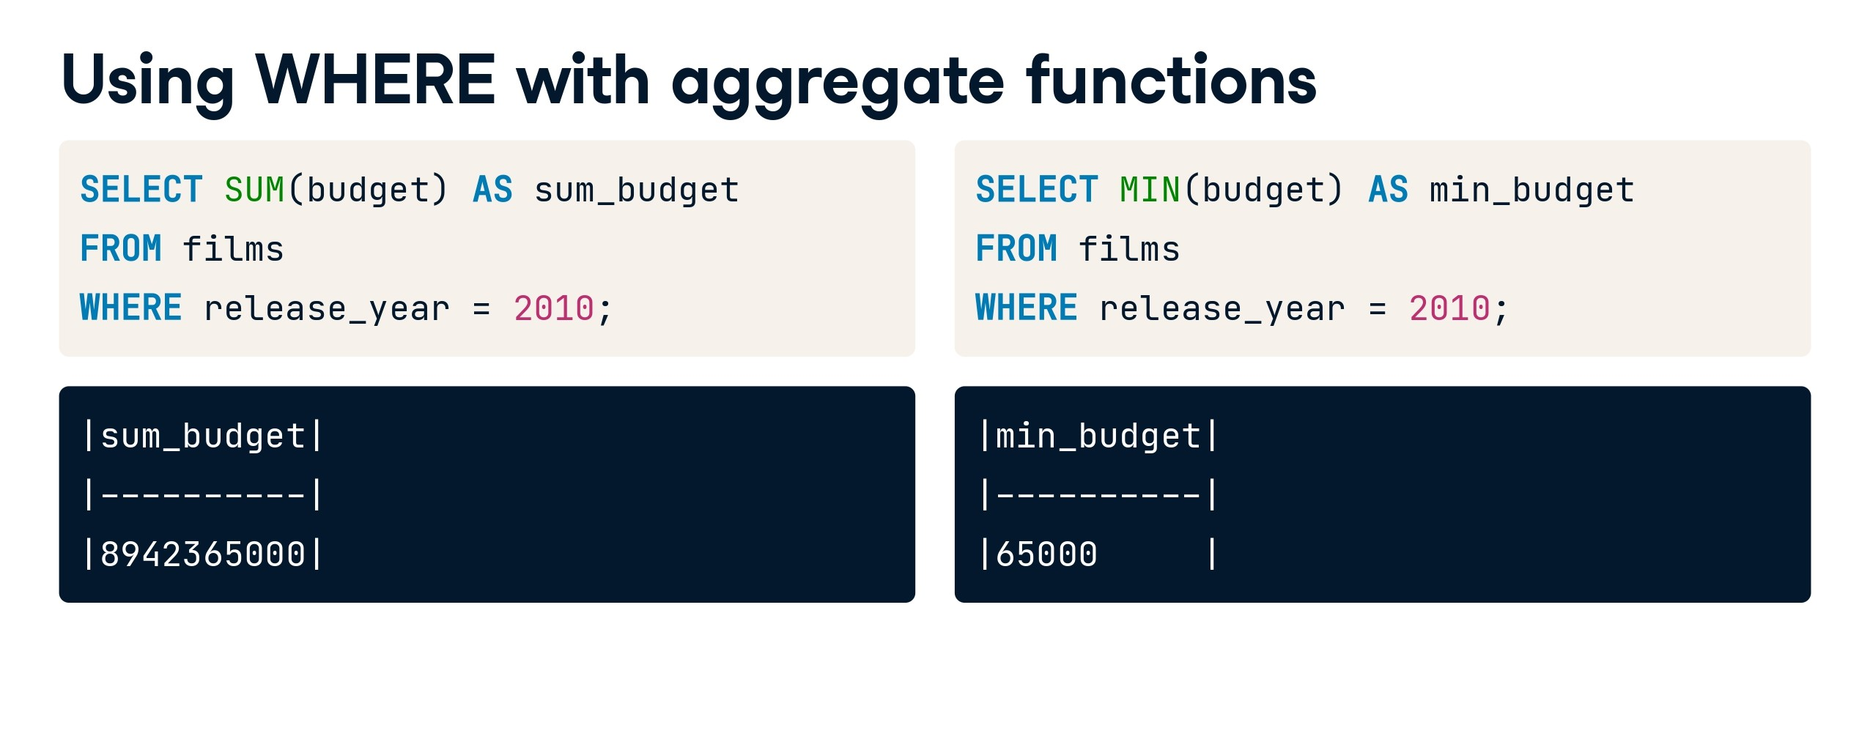

Slide 74
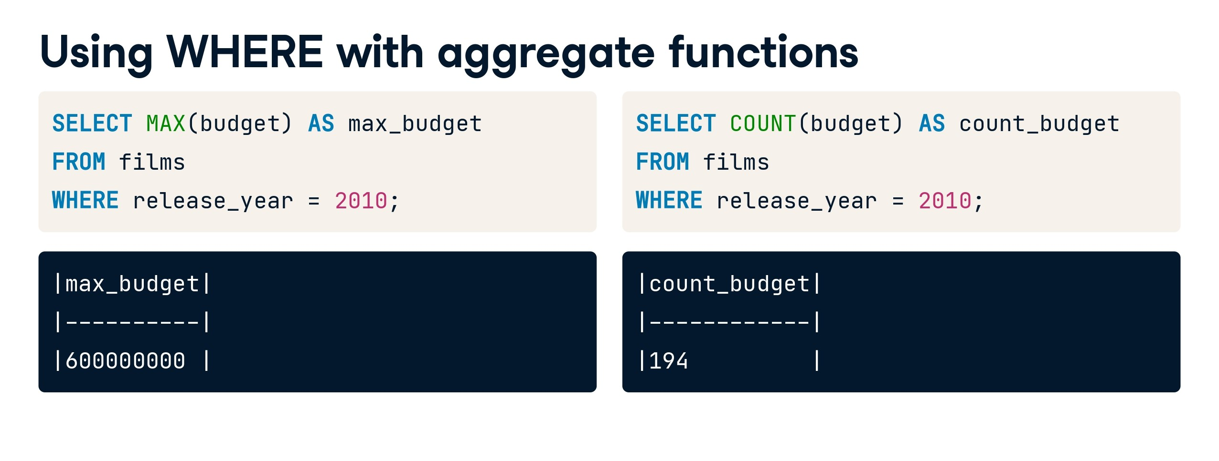

Slide 75
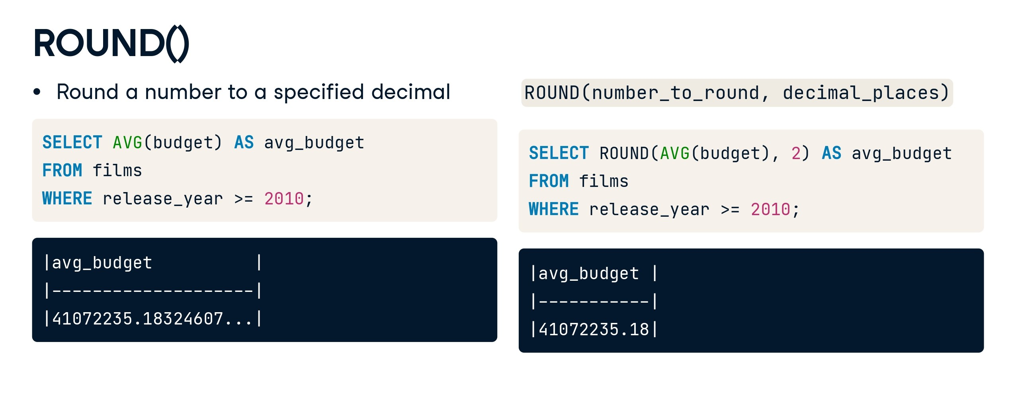

Slide 76
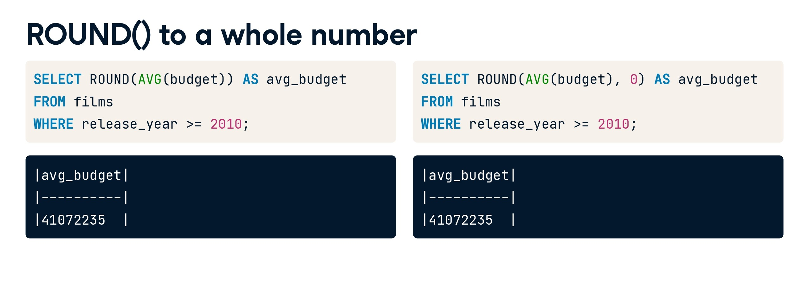

Slide 77
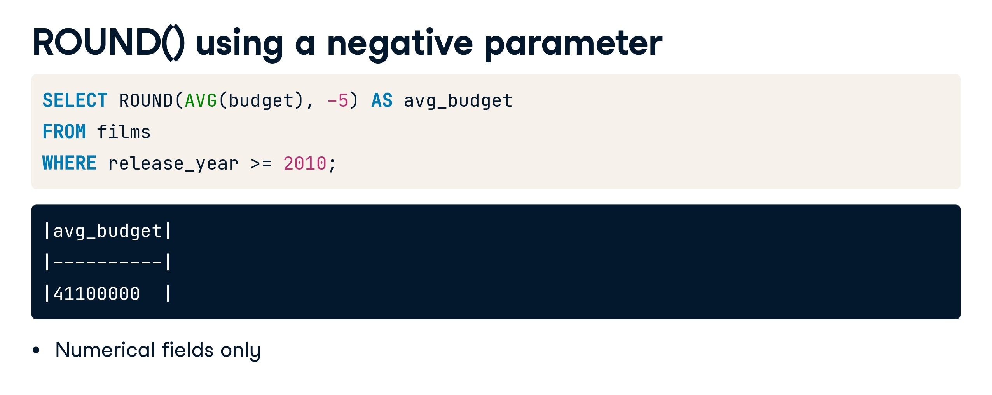

Slide 78


Slide 79
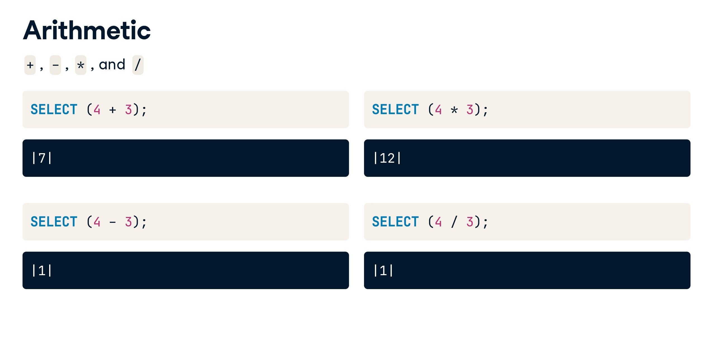

Slide 80
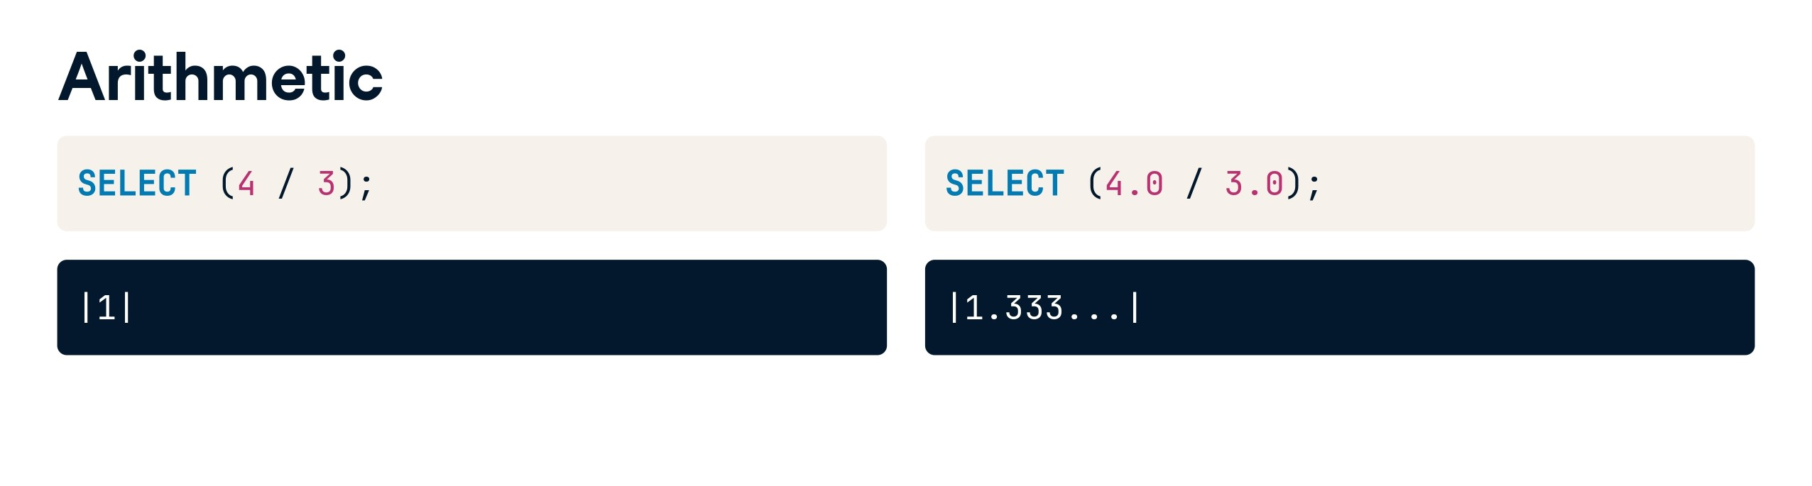

Slide 81
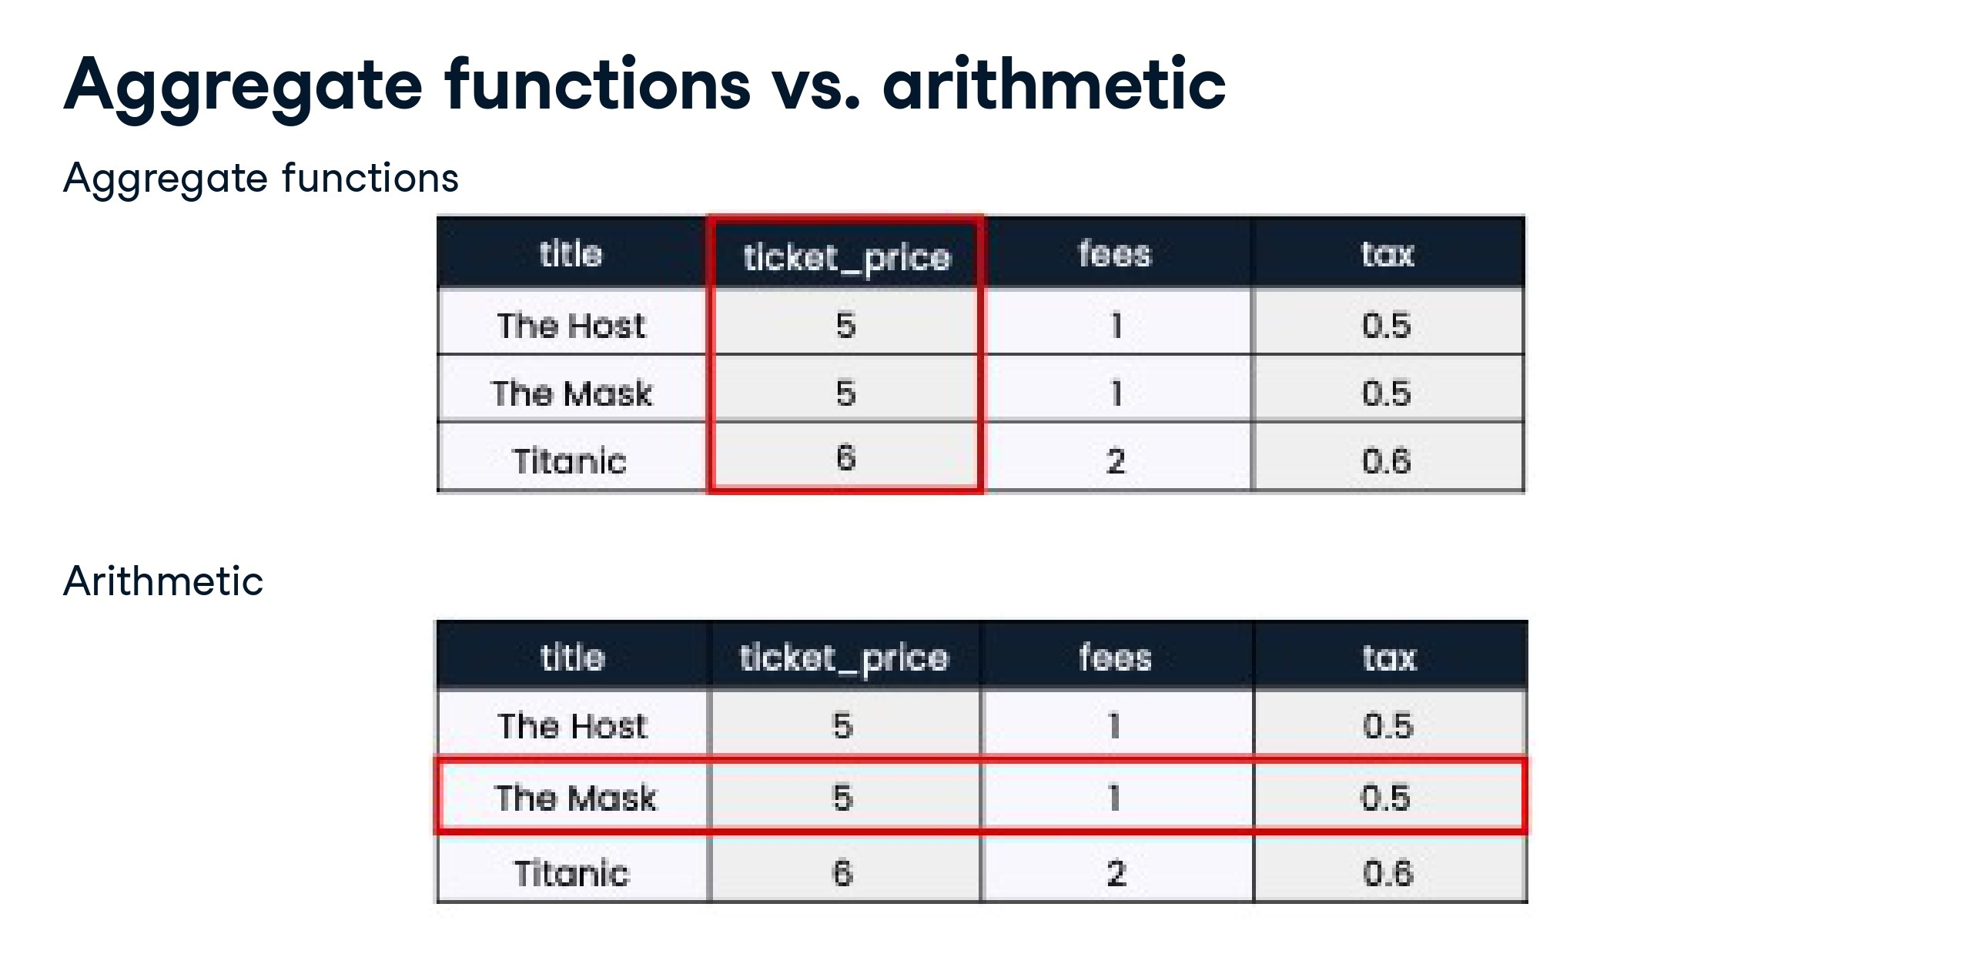

Slide 82
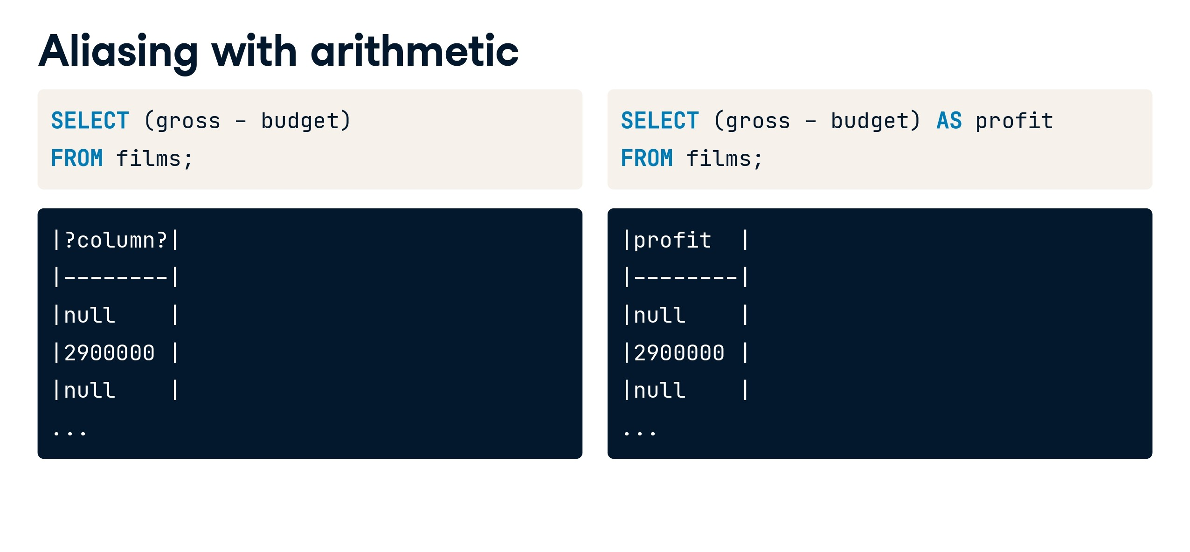

Slide 83
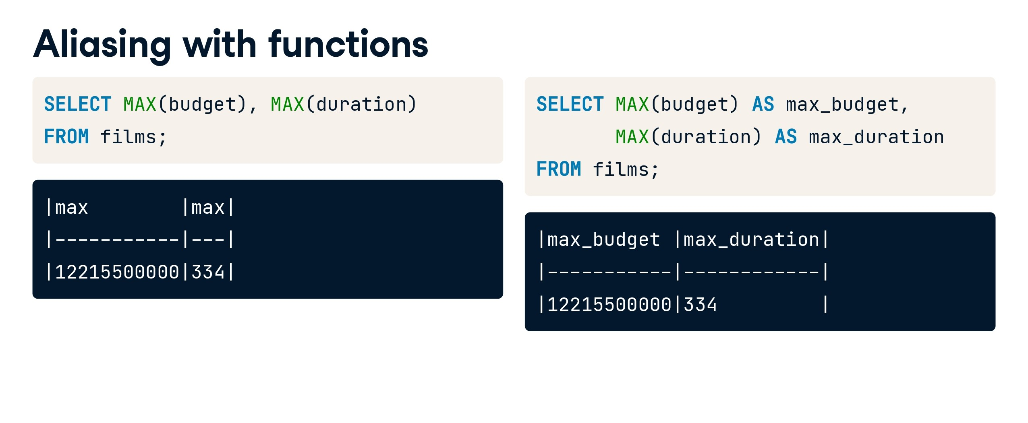

Slide 84
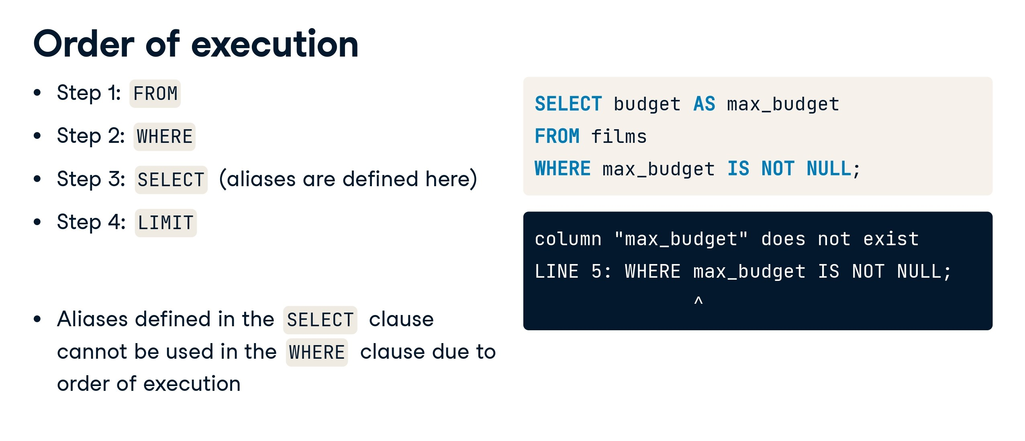

Slide 85
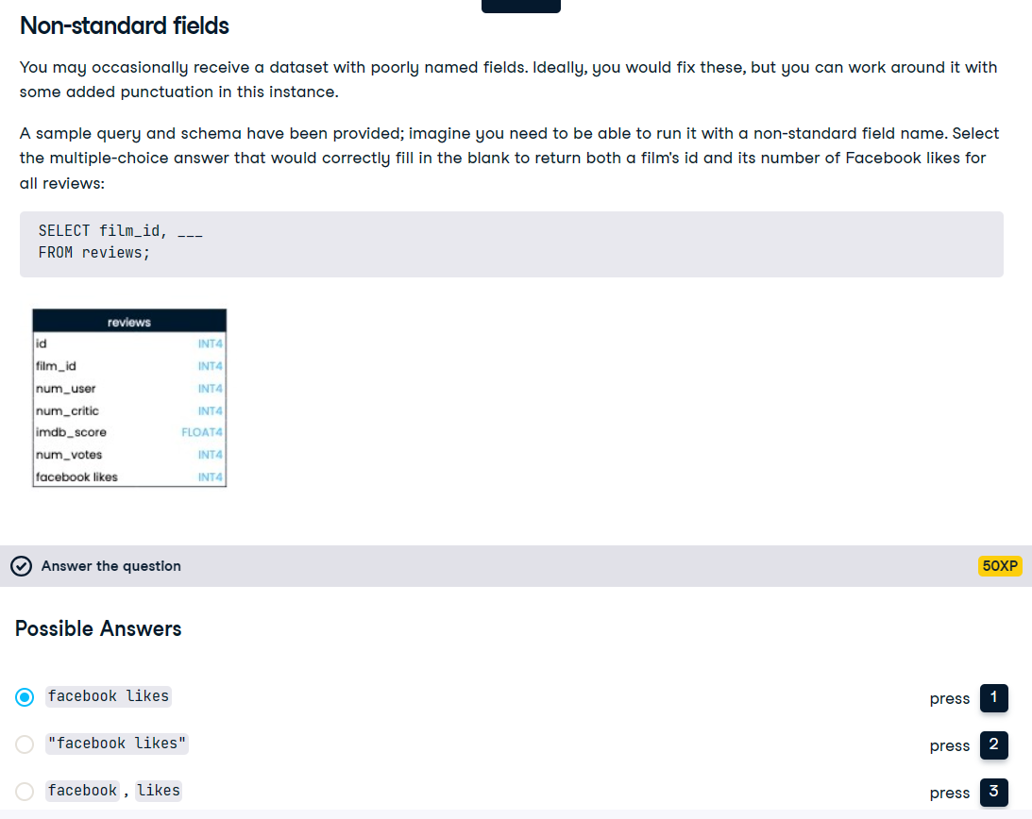

Slide 86


Slide 87


Slide 88
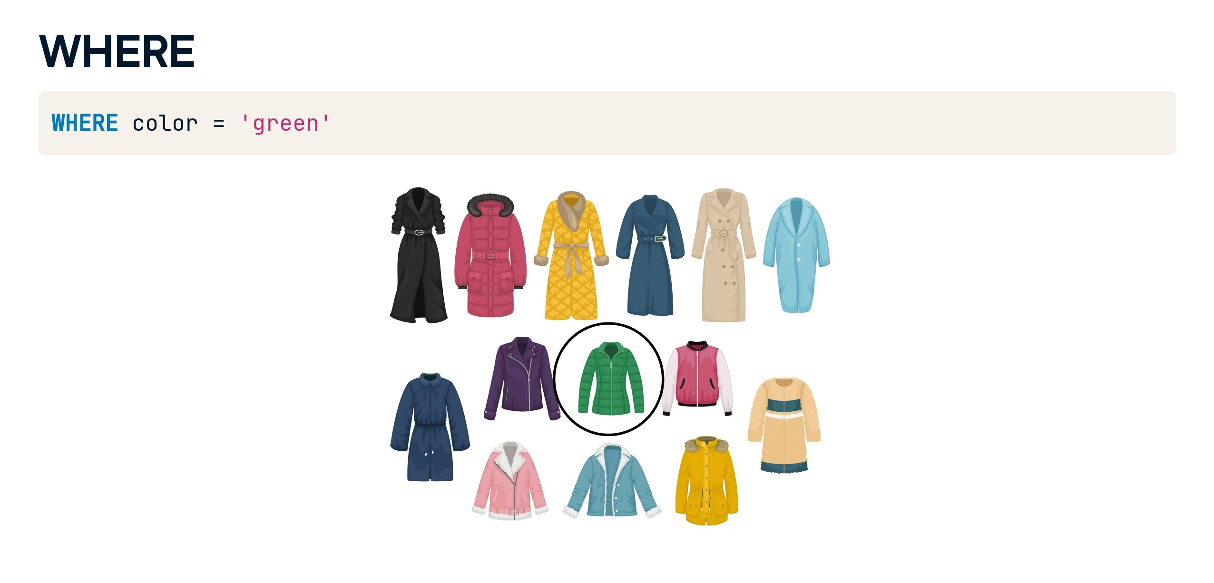

Slide 89
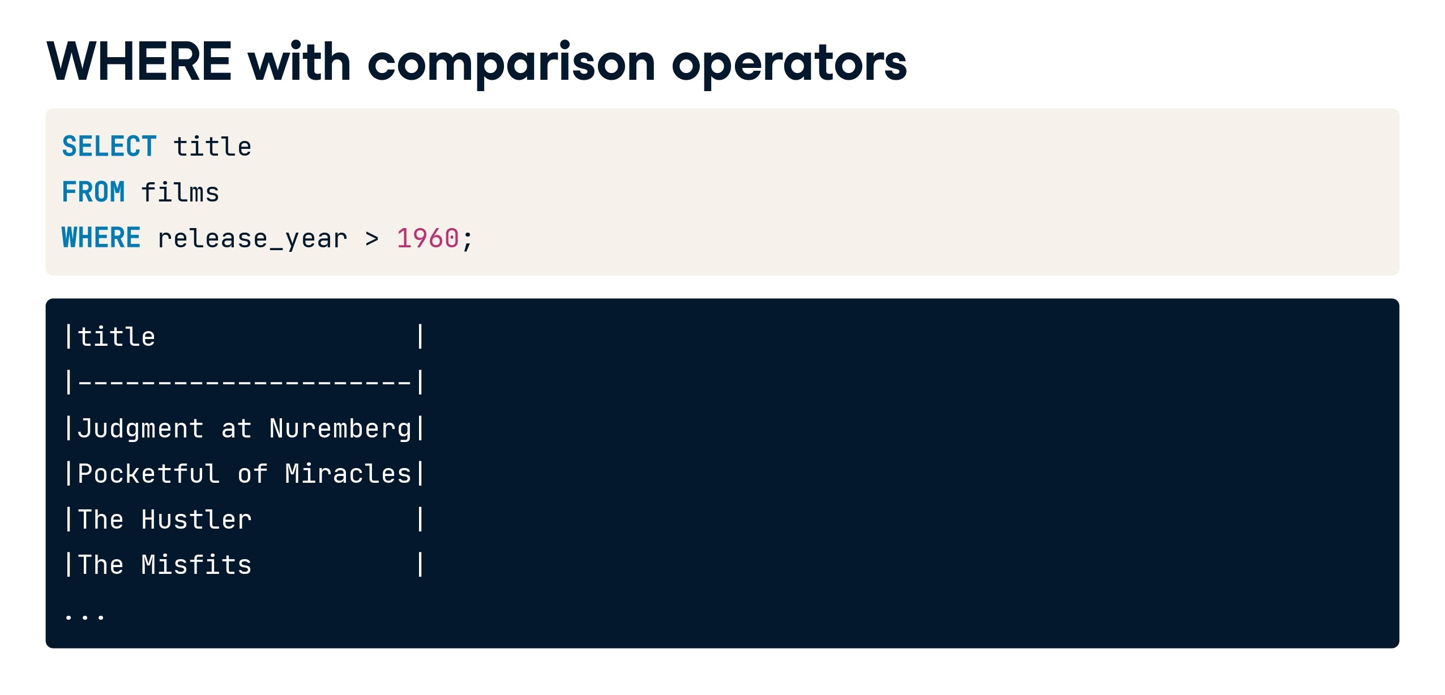

Slide 90
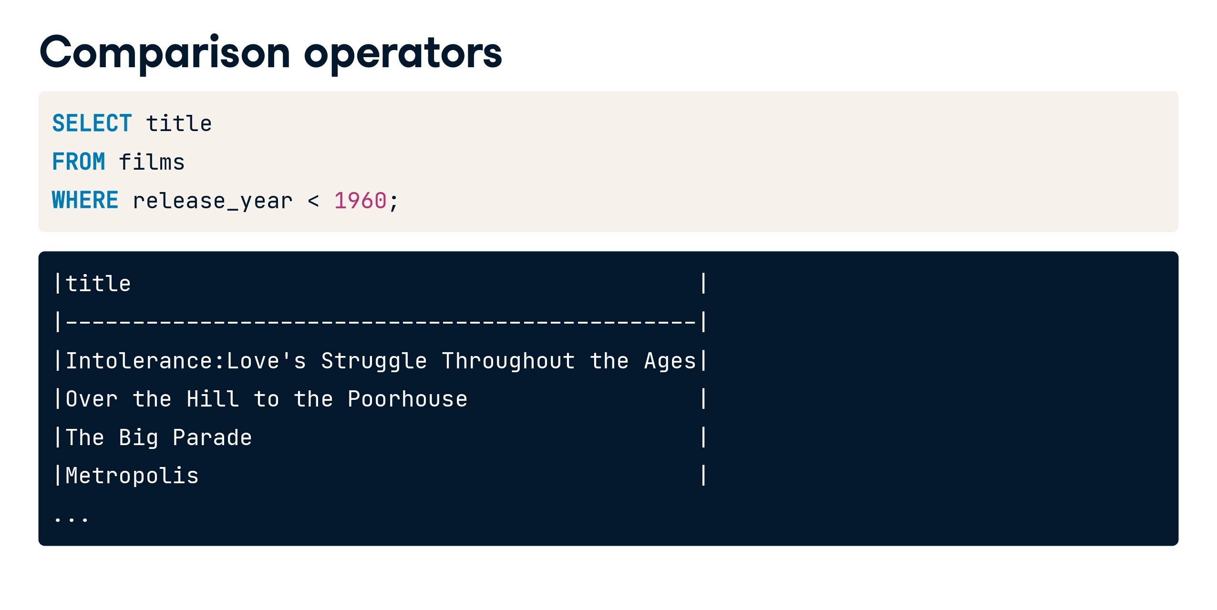

Slide 91
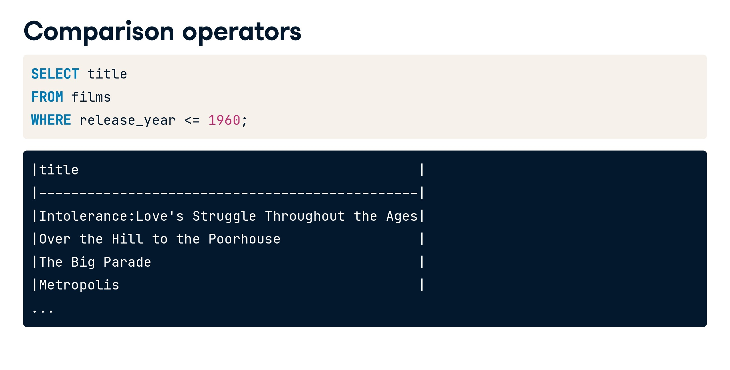

Slide 92
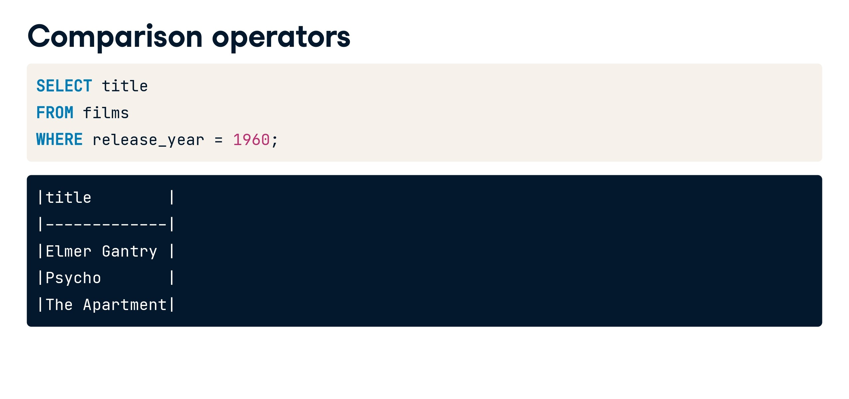

Slide 93
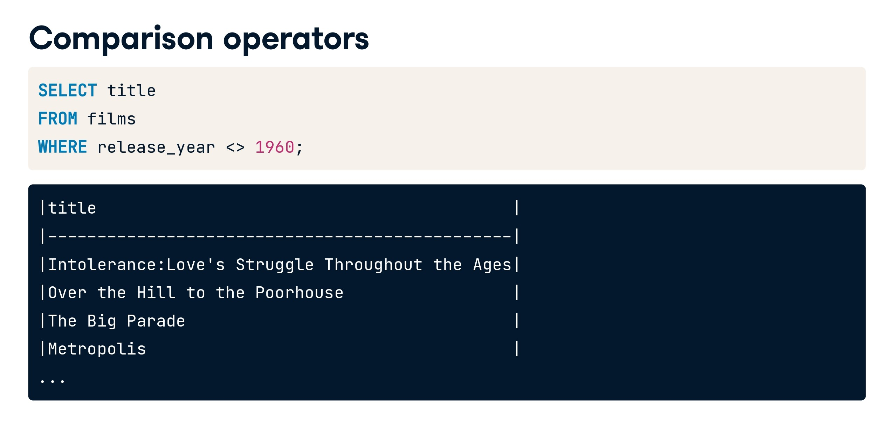

Slide 94
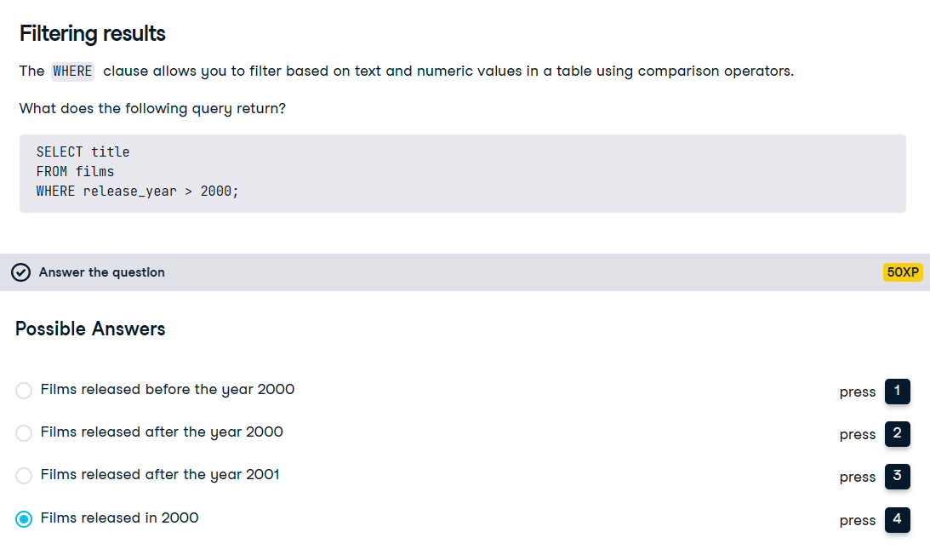

Slide 95
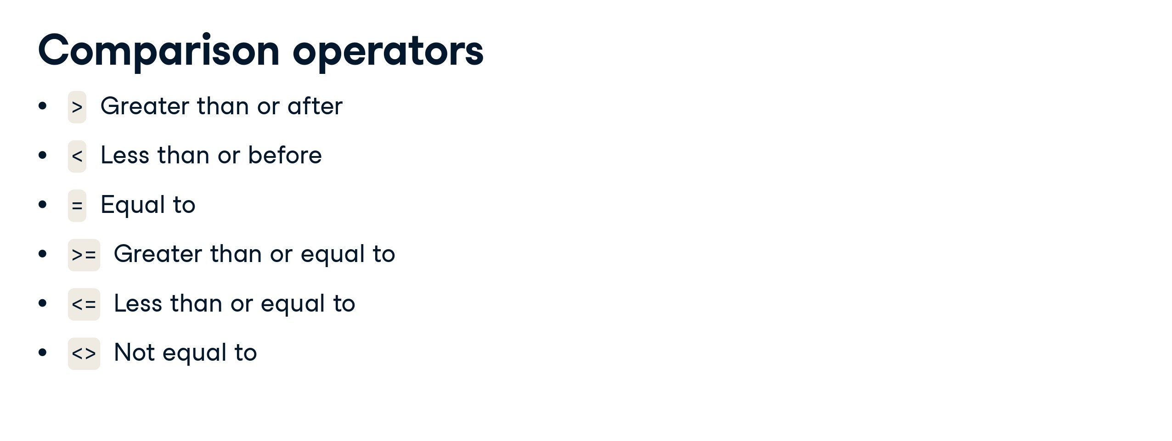

Slide 96
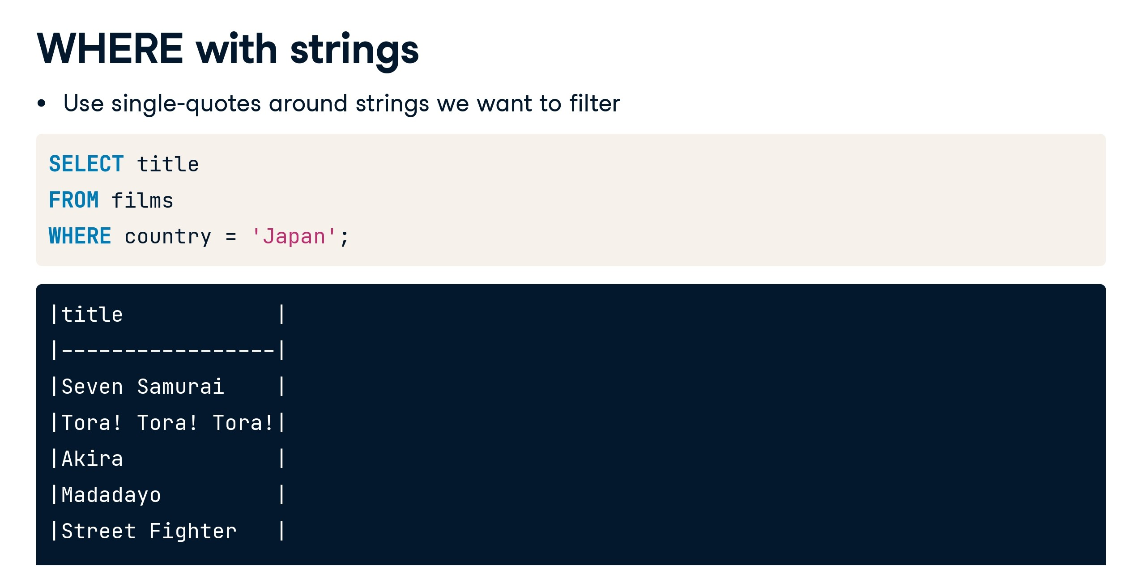

Slide 97
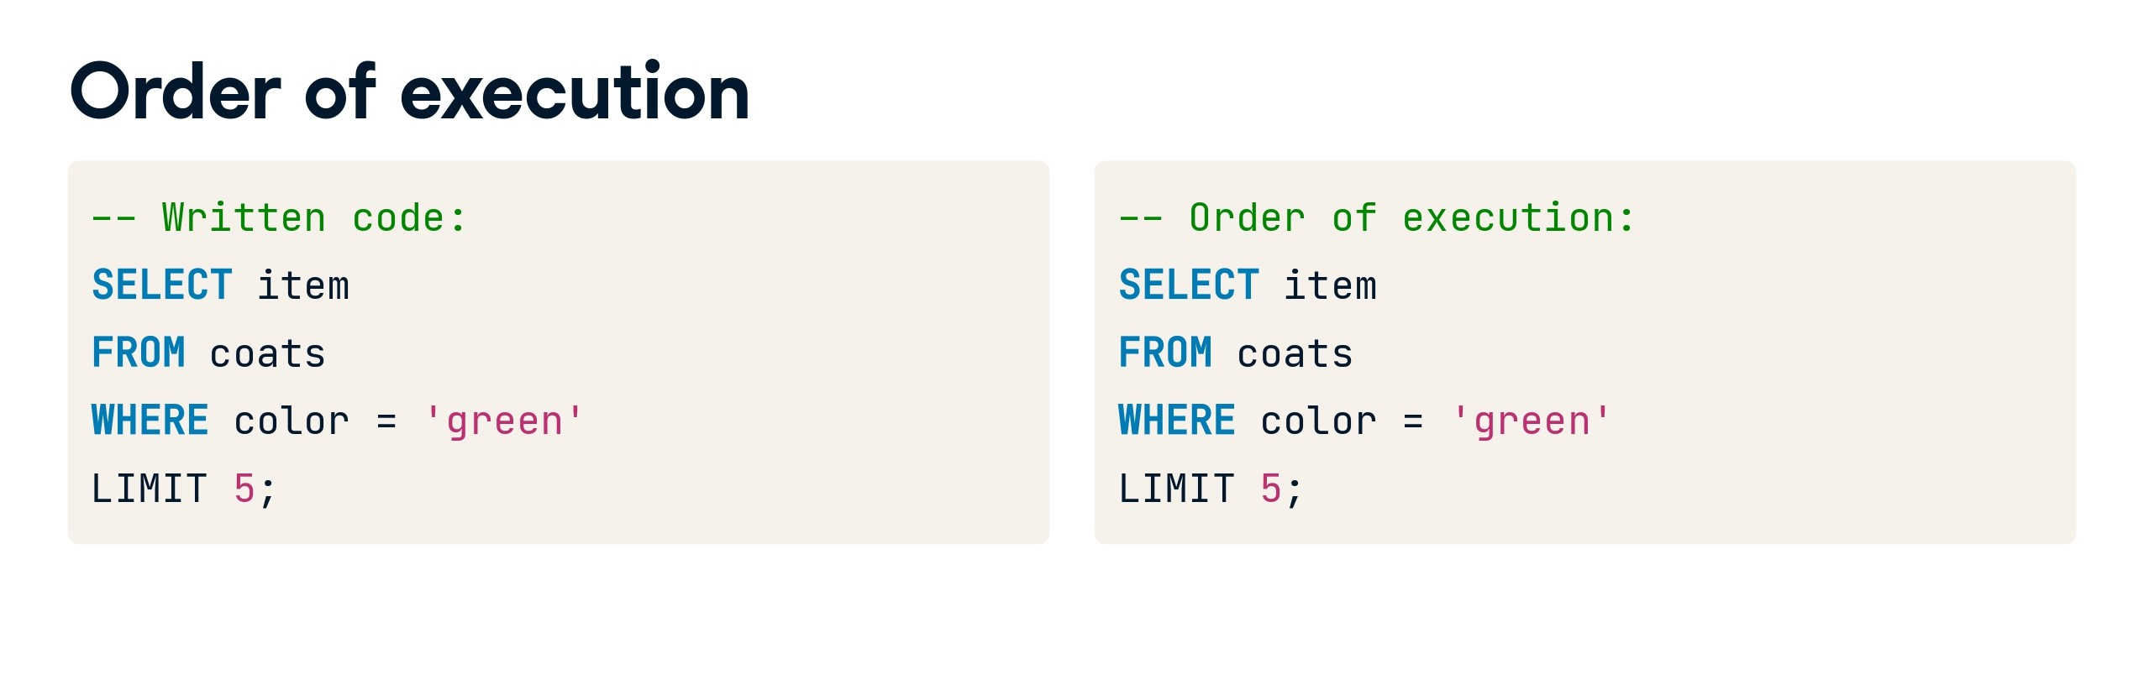

Slide 98
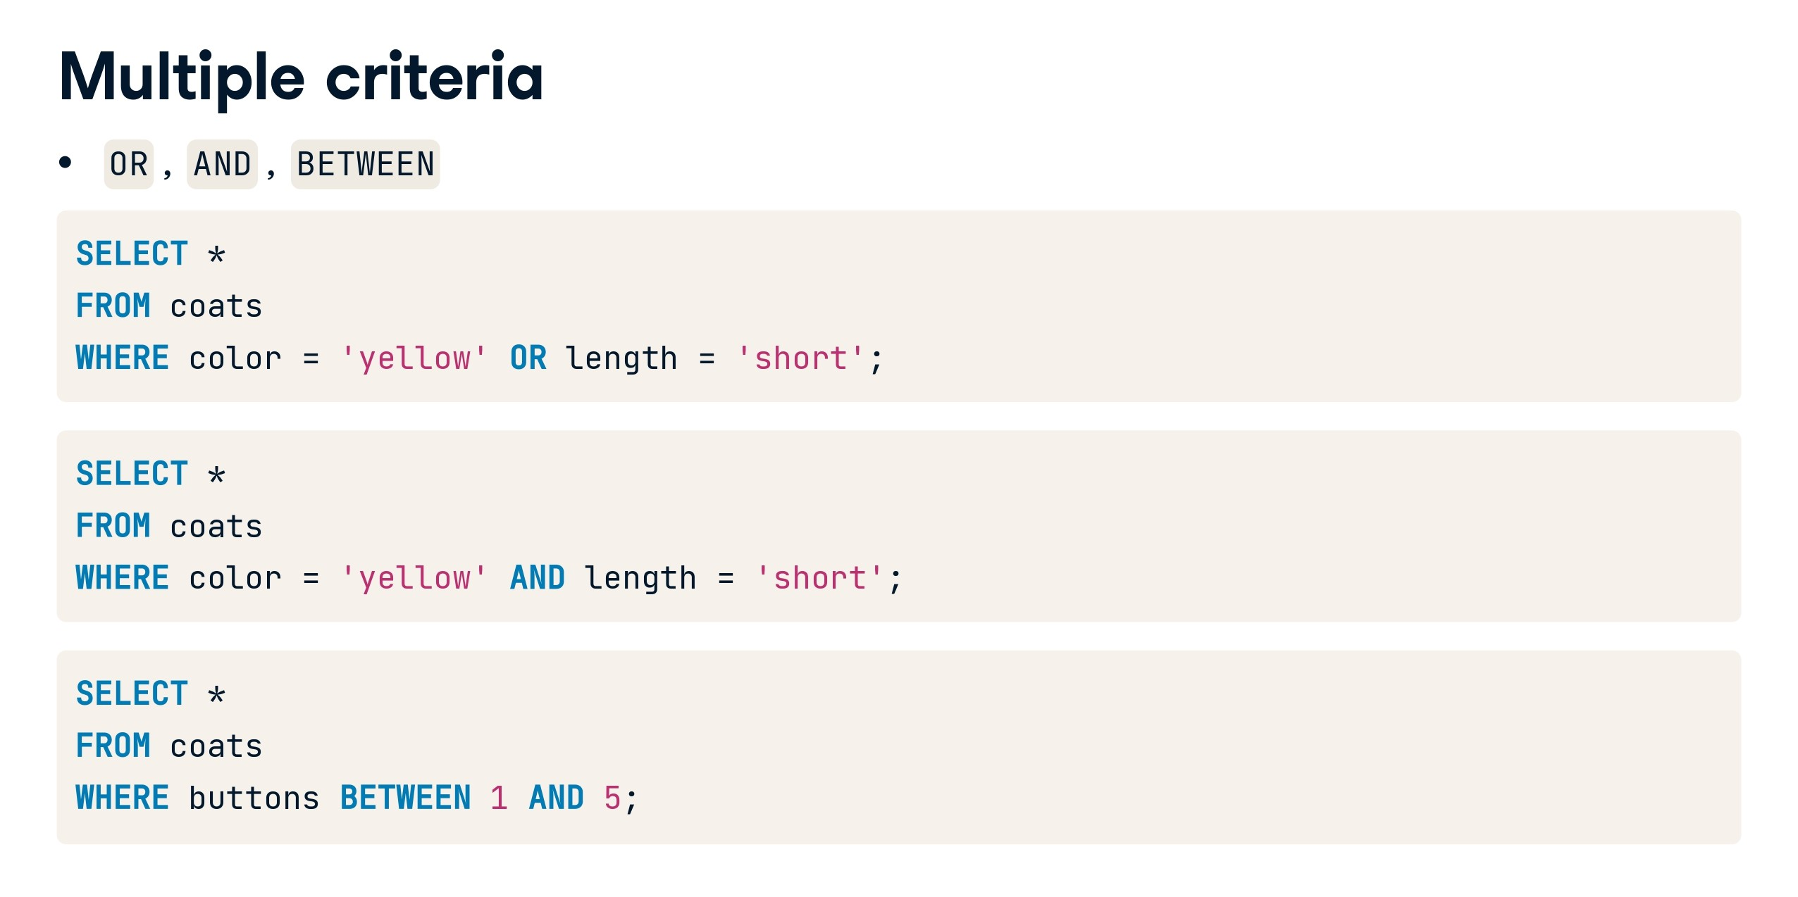

Slide 99
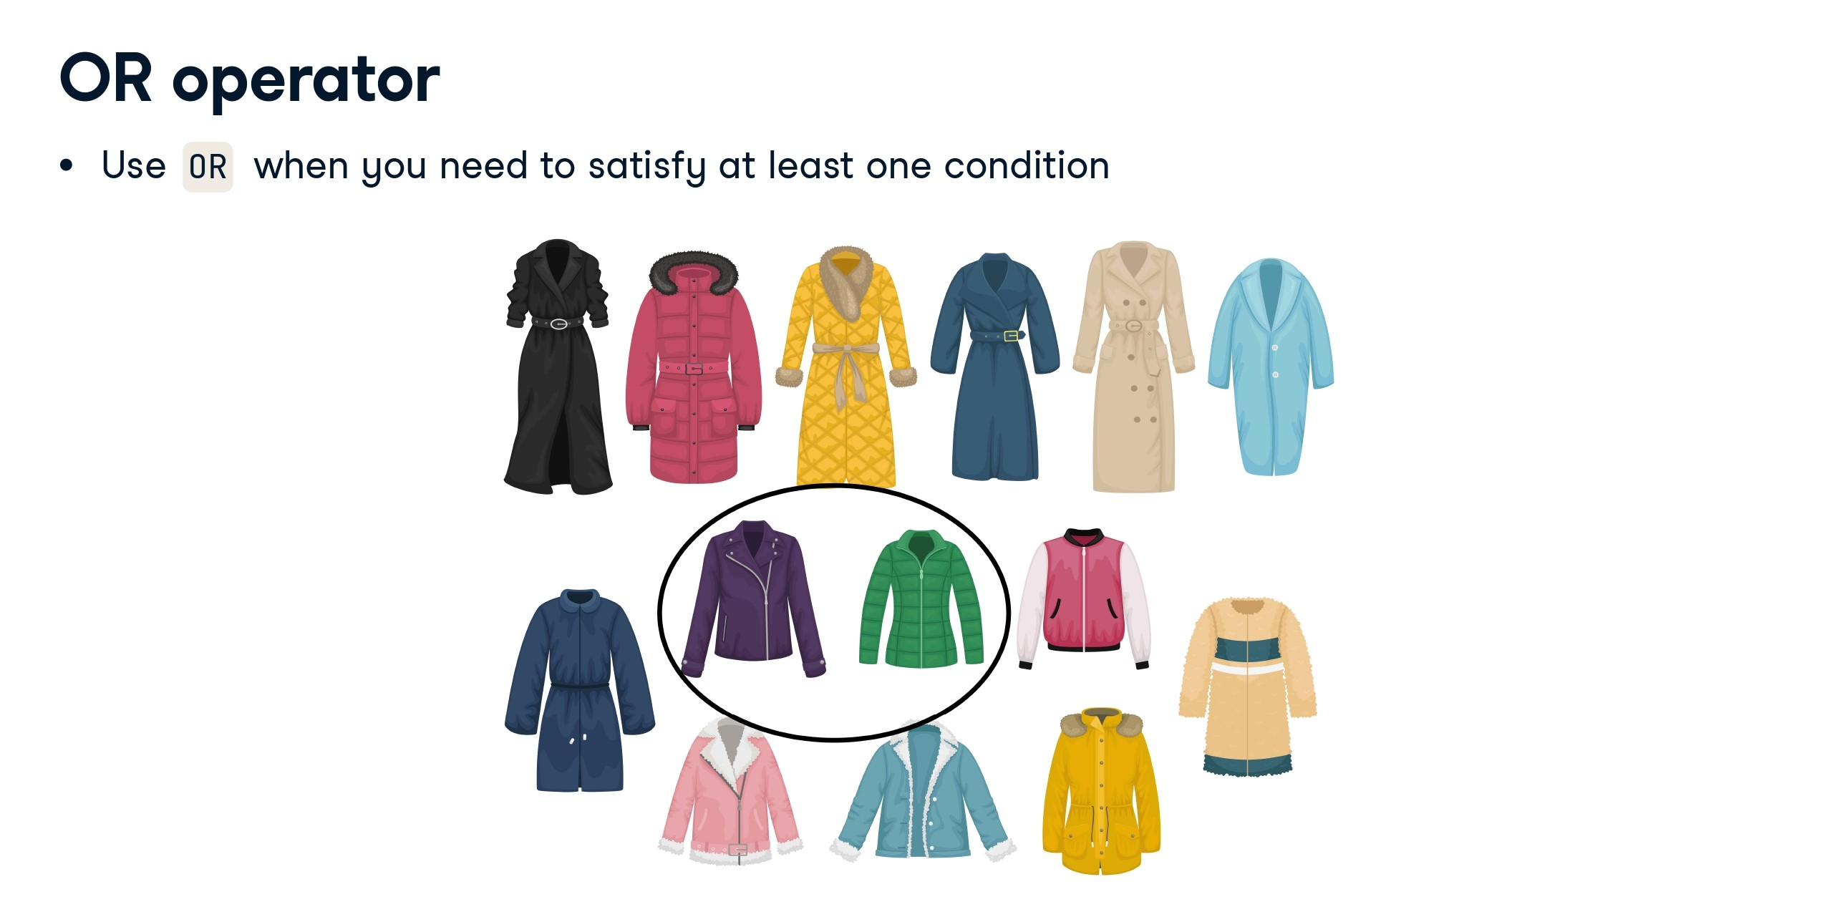

Slide 100
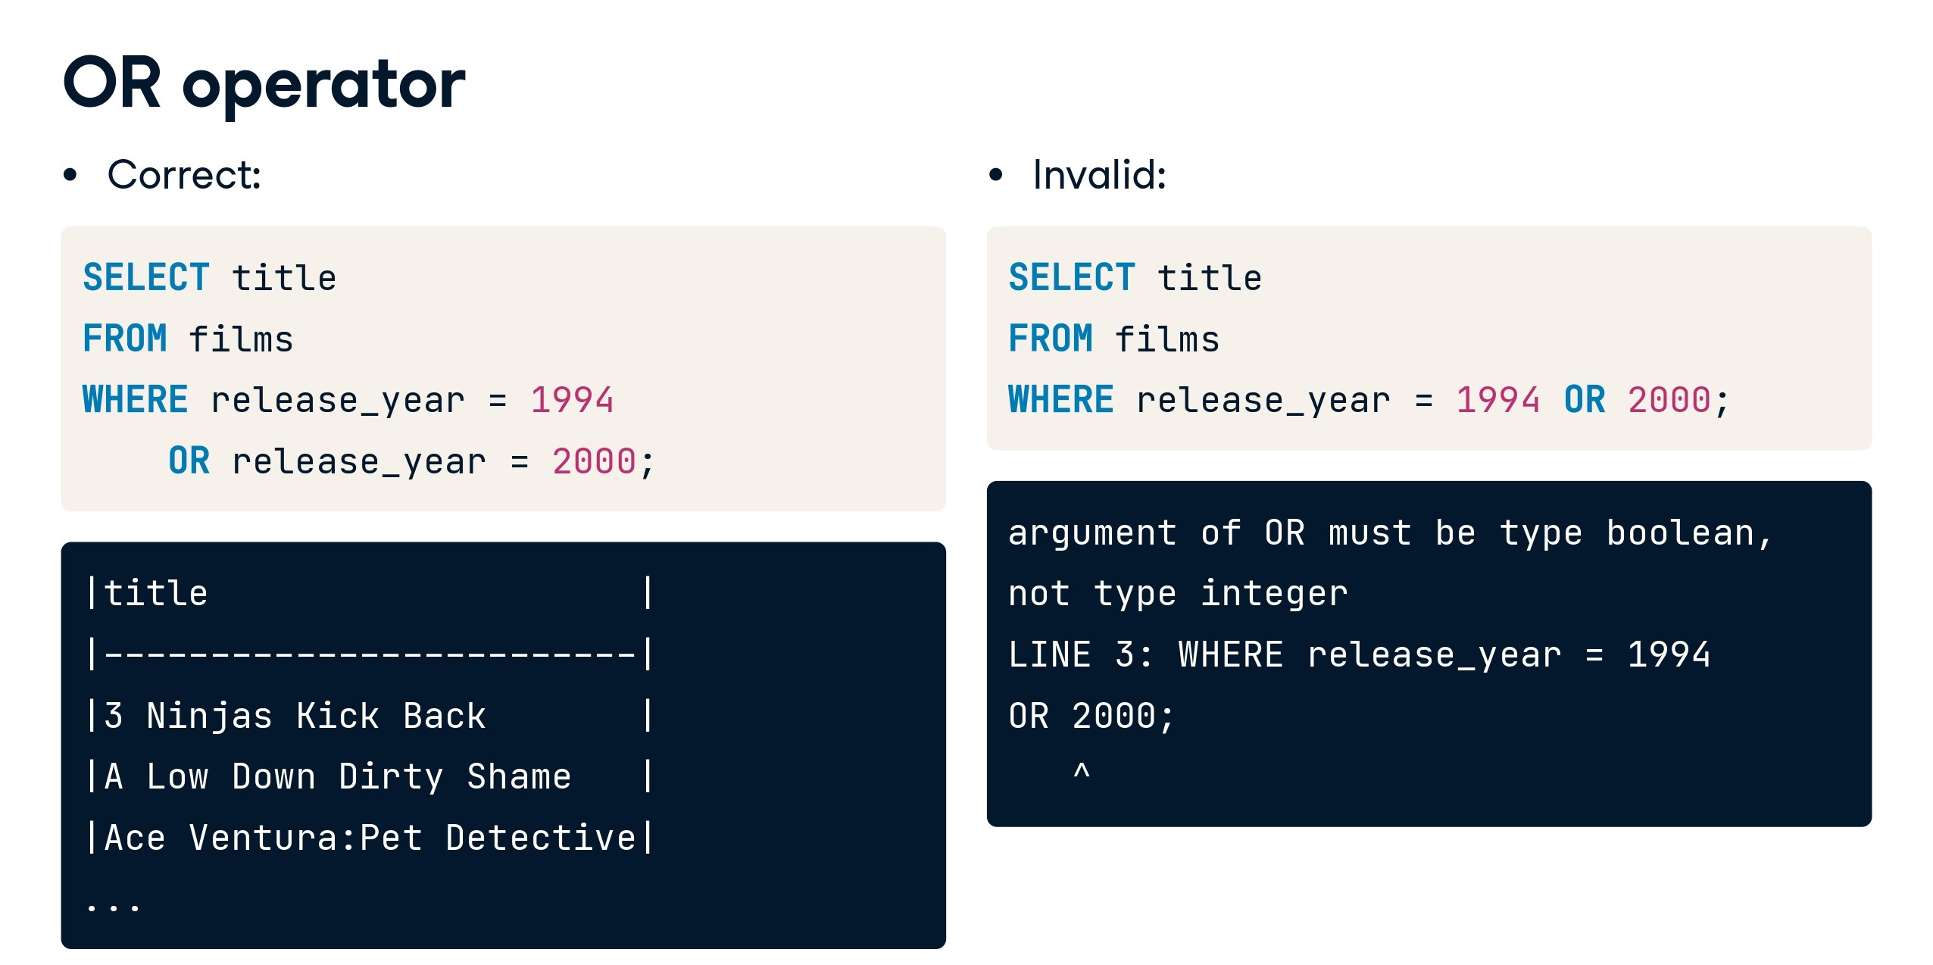

Slide 101
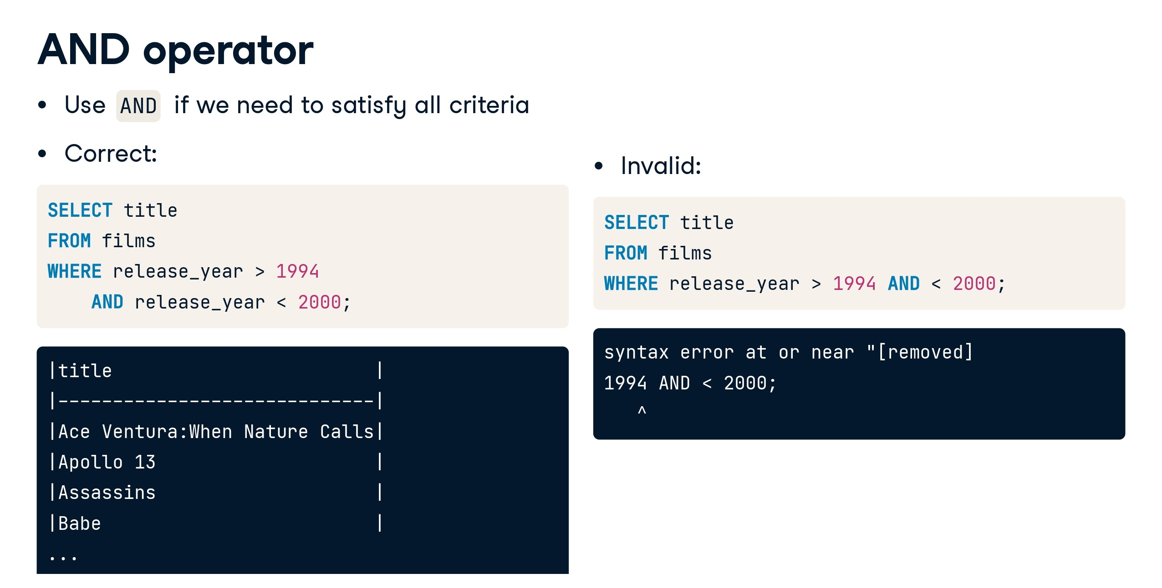

Slide 102
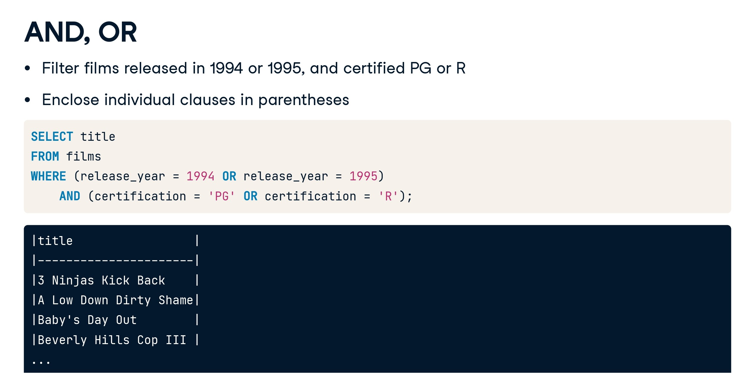

Slide 103
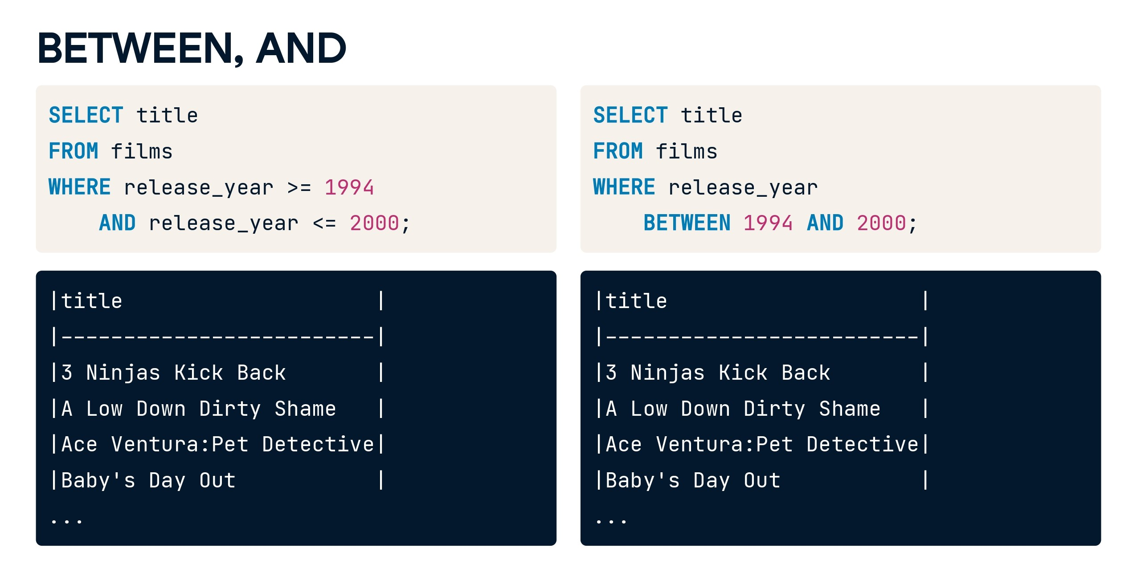

Slide 104
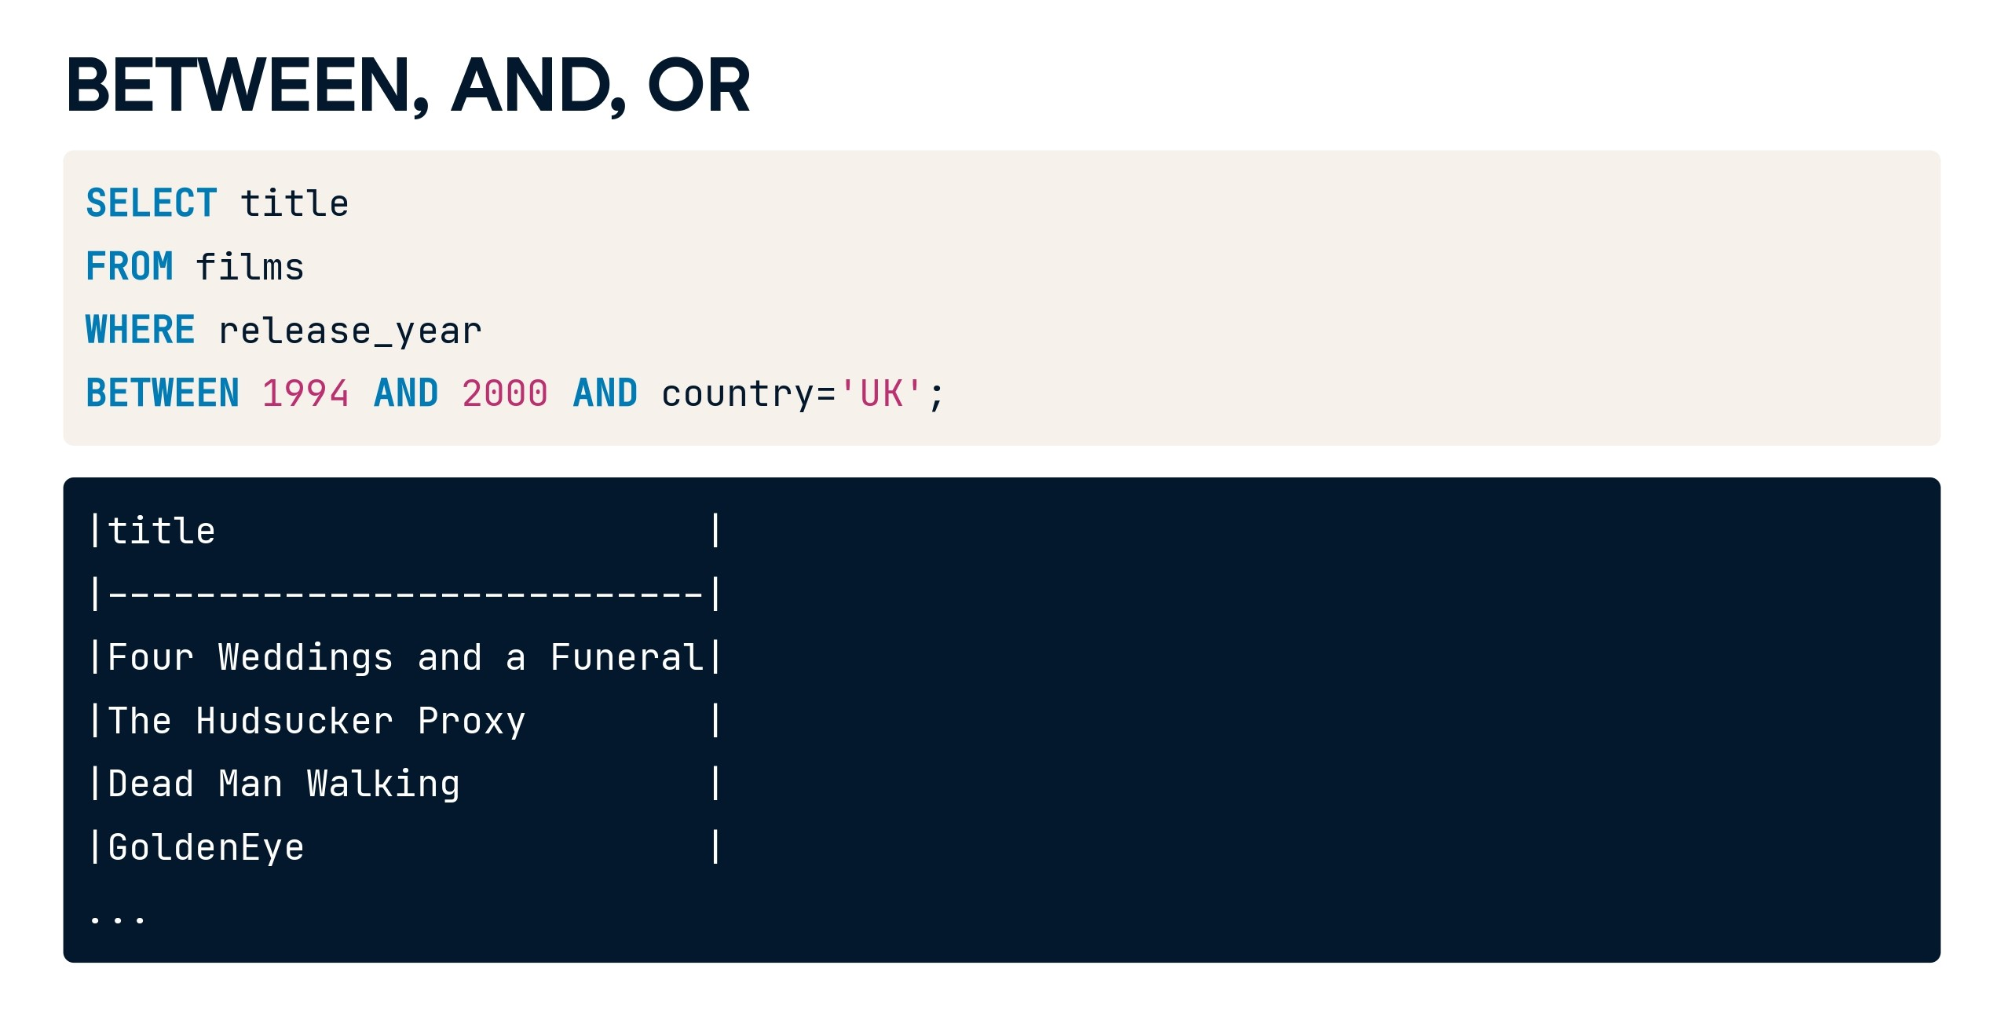

Slide 105
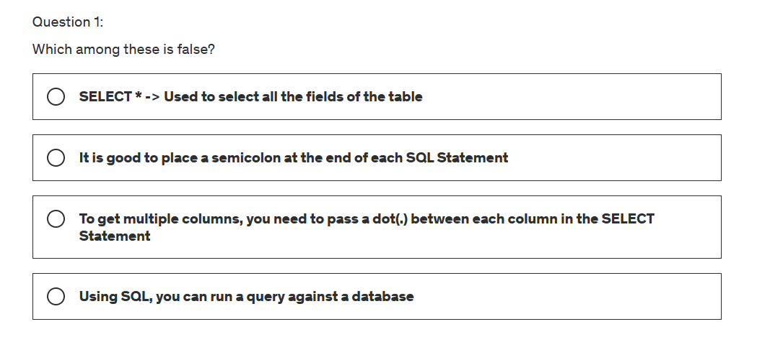

Slide 106
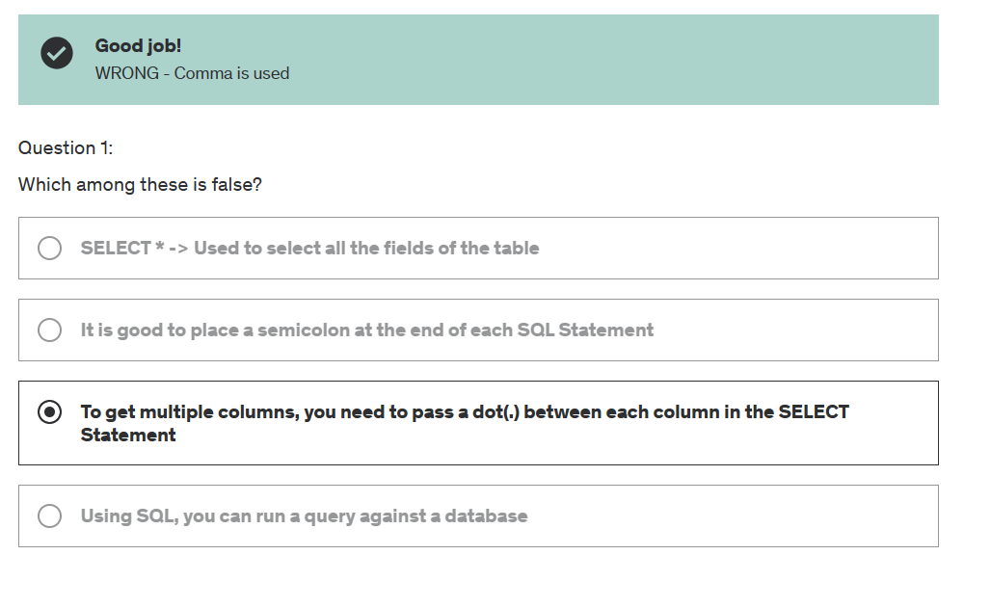

Slide 107
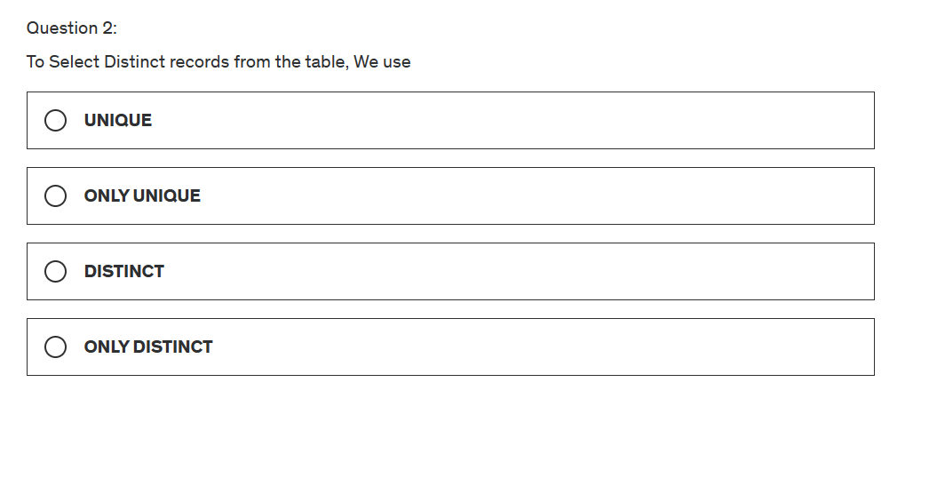

Slide 108
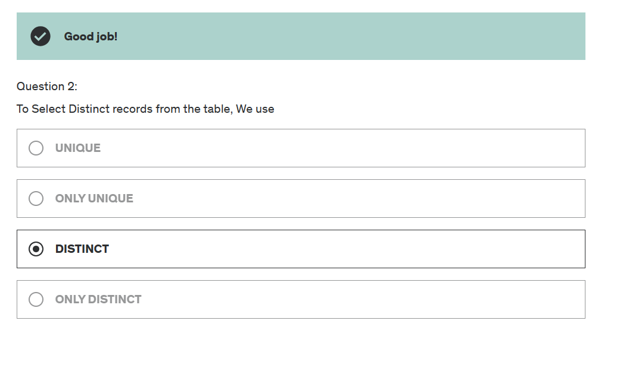

Slide 109
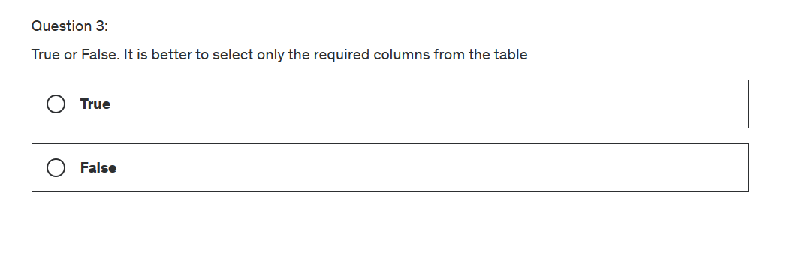

Slide 110
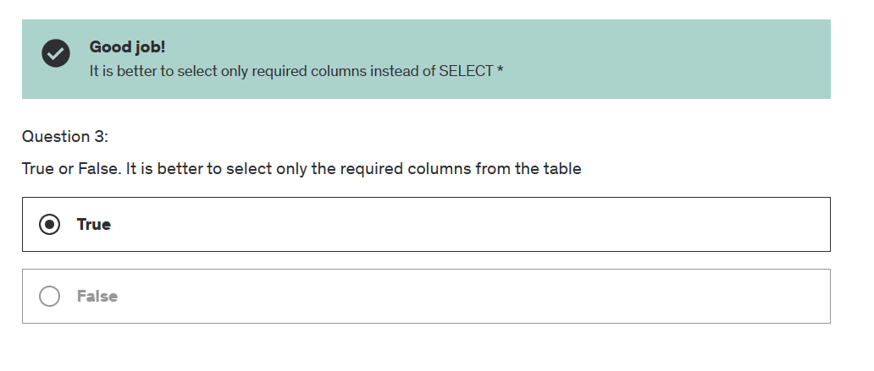

Slide 111
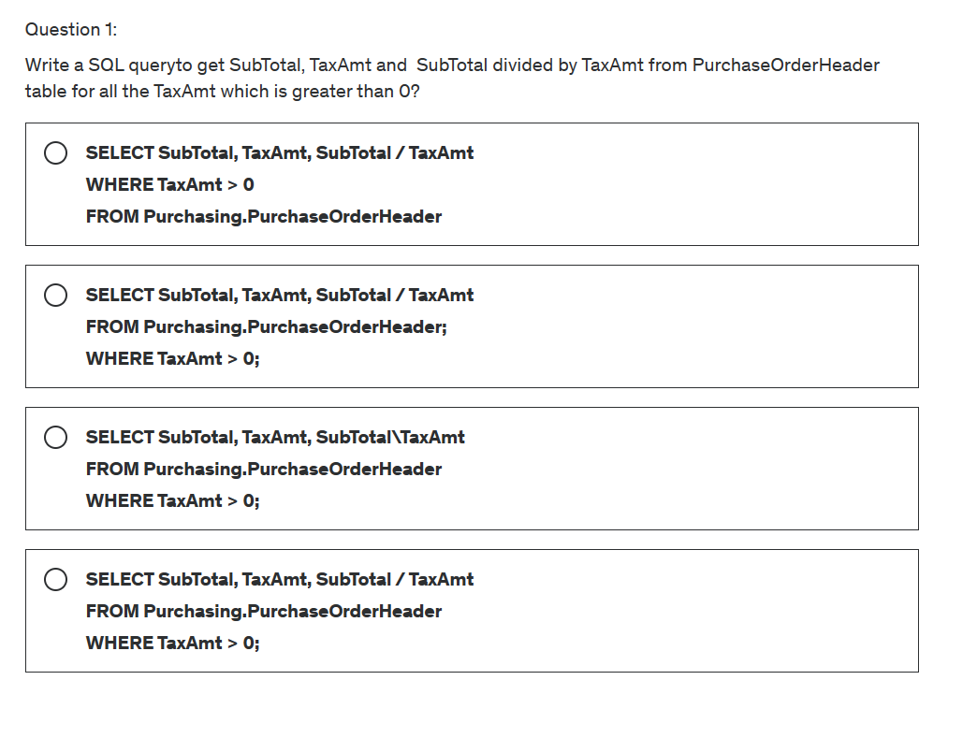

Slide 112
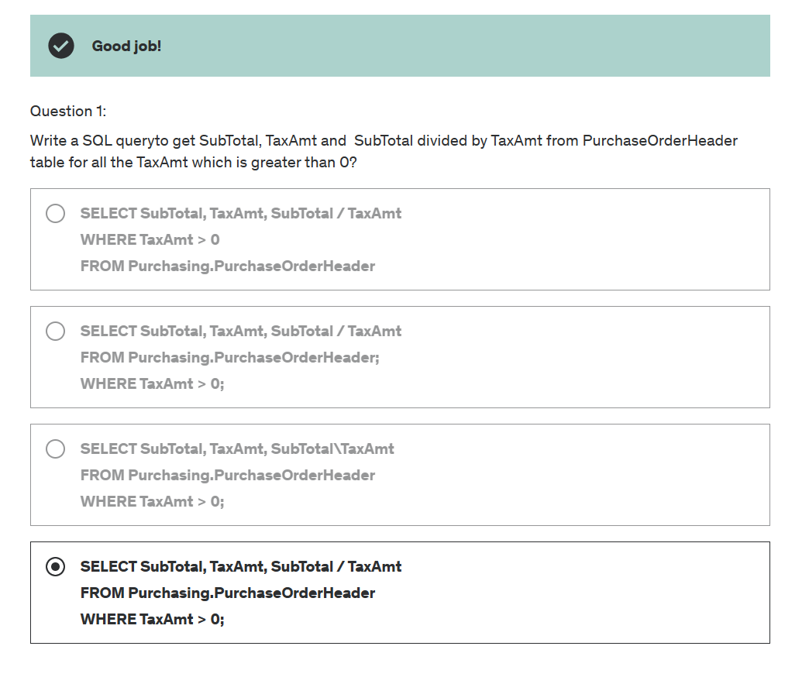

Slide 113


Slide 114


Slide 115


Slide 116


Slide 117


Slide 118


Slide 119
Case study 1
CREATE TABLE Employees (
emp_id INTEGER PRIMARY KEY,
first_name VARCHAR(50),
last_name VARCHAR(50),
department VARCHAR(50),
position VARCHAR(50),
hire_date DATE,
salary DECIMAL(10, 2),
years_of_exp INTEGER
);

Slide 120
INSERT INTO Employees (emp_id, first_name, last_name, department, position, hire_date, salary, years_of_exp)
VALUES
(1, 'John', 'Doe', 'Sales', 'Sales Manager', '2020-01-15', 55000.00, 5),
(2, 'Jane', 'Smith', 'Finance', 'Financial Analyst', '2019-07-08', 48000.00, 3),
(3, 'Mike', 'Johnson', 'IT', 'Software Engineer', '2021-03-20', 65000.00, 7),
(4, 'Emily', 'Williams', 'HR', 'HR Manager', '2018-05-10', 60000.00, 8),
(5, 'David', 'Brown', 'Sales', 'Sales Representative', '2022-02-05', 42000.00, 2);

Slide 121
INSERT INTO Employees (emp_id, first_name, last_name, department, position, hire_date, salary, years_of_exp)
VALUES
(6, ‘Sachin', 'Doe', 'Sales', 'Sales Manager', '2024-01-15', 15000.00, 1),
(7, ‘Jyoti', 'Smith', 'Finance', 'Financial Analyst', '2018-07-08', 28000.00, 2),
(8, 'Mehndi', 'Johnson', 'IT', 'Software Engineer', '2024-03-20', 35000.00, 3),
(9, 'Elli', 'Williams', 'HR', Financial Analysts', '2010-05-10', 40000.00, 4),
(10, 'Devid', 'Brown', 'Sales', 'Sales Representative', '2021-02-12', 52000.00, 5);

Slide 122
INSERT INTO Employees (emp_id, first_name, last_name, department, position, hire_date, salary, years_of_exp)
VALUES
(11, ‘Saad', 'Doe', 'Sales', 'Sales Manager', '2024-01-15', 15000.00, 1),
(12, ‘Jama', 'Smith', 'Finance', 'Financial Analyst', '2020-07-08', 28000.00, 6),
(13, 'Mehul', 'Johnson', 'IT', 'Software Engineer', '2024-03-20', 35000.00, 5),
(14, 'Ekram', 'Williams', 'HR', Financial Analysts', '2019-05-10', 40000.00, 4),
(15, 'Dwe', 'Brown', 'Sales', 'Sales Representative', '2023-02-05', 52000.00, 3);

Slide 123
Question 1:
let's solve some more complex problems using the WHERE clause:
Select employees from the Sales department who have more than 4 years of experience.

Slide 124
Solution 1:
Select employees from the Sales department who have more than 4 years of experience:
SELECT *
FROM Employees
WHERE department = 'Sales' AND years_of_exp > 4;

Slide 125
Question 2: Select employees whose hire date is before January 1, 2021, and their salary is greater than 50000.

Slide 126
Solution 2:
Select employees whose hire date is before January 1, 2021, and their salary is greater than 50000.
SELECT * FROM Employees WHERE hire_date < '2021-01-01' AND salary > 50000.00;

Slide 127


Slide 128


Slide 129


Slide 130


Slide 131


Slide 132


Slide 133


Slide 134


Slide 135


Slide 136


Slide 137


Slide 138


Slide 139


Slide 140


Slide 141


Slide 142


Slide 143


Slide 144
Question 3:
Select employees whose hire date is before January 1, 2021, and their salary is greater than 50000.
Question 4:
Select employees whose first name starts with 'J' and are either Financial Analysts or HR Managers.

Slide 145
Solution 3:
Select employees whose hire date is before January 1, 2021, and their salary is greater than 50000.
SELECT * FROM Employees WHERE hire_date < '2021-01-01' AND salary > 50000.00;
Solution 4:
Select employees whose first name starts with 'J' and are either Financial Analysts or HR Managers.
SELECT * FROM Employees WHERE first_name LIKE 'J%' AND (position = 'Financial Analyst' OR position = 'HR Manager’);

Slide 146
Question 5:
Select employees whose salary is within a specific range and sort the result by salary in descending order.
Question 6: Select employees with more than 5 years of experience or whose salary is greater than 55000, and are not part of the IT department.

Slide 147
Solution 5:
Select employees whose salary is within a specific range and sort the result by salary in descending order.
SELECT * FROM Employees WHERE salary BETWEEN 40000.00 AND 60000.00 ORDER BY salary DESC;
Solution 6: Select employees with more than 5 years of experience or whose salary is greater than 55000, and are not part of the IT department.
SELECT * FROM Employees WHERE (years_of_exp > 5 OR salary > 55000.00) AND department <> 'IT'; These examples demonstrate some more complex scenarios using

Slide 148
Question 7: Problem Statement: You are given a table that contains email addresses of users. Write a SQL query to find all duplicate email IDs and their count.
Table Description: `users` Table: - `id` (integer, primary key, not null): The unique identifier for each user. - `email` (string): The email address of the user.

Slide 149
CREATE TABLE users ( id INTEGER PRIMARY KEY, email VARCHAR(255) ); #### Data Insertion: INSERT INTO users (id, email) VALUES (1, 'john.doe@example.com'), (2, 'jane.smith@example.com'), (3, 'john.doe@example.com'), (4, 'mary.jane@example.com'), (5, 'jane.smith@example.com');

Slide 150

Solution:
SELECT email, COUNT(*) AS count FROM
users GROUP BY email HAVING COUNT(*) > 1;

Slide 151
Problem Statement 8: Write a SQL query to find emp_id who is inside the hospital.
Script: Table creation statement and insert statements.
create table hospital ( emp_id int, action varchar(10), time datetime);
insert into hospital values ('1', 'in', '2019-12-22 09:00:00');
insert into hospital values ('1', 'out', '2019-12-22 09:15:00');
insert into hospital values ('2', 'in', '2019-12-22 09:00:00');
insert into hospital values ('2', 'out', '2019-12-22 09:15:00');
insert into hospital values ('2', 'in', '2019-12-22 09:30:00');
insert into hospital values ('3', 'out', '2019-12-22 09:00:00');
insert into hospital values ('3', 'in', '2019-12-22 09:15:00');
insert into hospital values ('3', 'out', '2019-12-22 09:30:00');
insert into hospital values ('3', 'in', '2019-12-22 09:45:00');
insert into hospital values ('4', 'in', '2019-12-22 09:45:00');
insert into hospital values ('5', 'out', '2019-12-22 09:40:00');

Slide 152

Solution:
select * from hospital
SELECT emp_id
FROM hospital h1
WHERE time = (
SELECT MAX(time)
FROM hospital h2
WHERE h1.emp_id = h2.emp_id
)
AND action = 'in';

Slide 153
Question 9: Reference Key
CREATE TABLE Authors (
AuthorID INT PRIMARY KEY IDENTITY(1,1),
FirstName NVARCHAR(50),
LastName NVARCHAR(50)
);
CREATE TABLE Publishers (
PublisherID INT PRIMARY KEY IDENTITY(1,1),
PublisherName NVARCHAR(100)
);

Slide 154
CREATE TABLE Books (
BookID INT PRIMARY KEY IDENTITY(1,1),
Title NVARCHAR(200),
AuthorID INT,
PublisherID INT,
PublicationYear INT,
FOREIGN KEY (AuthorID) REFERENCES Authors(AuthorID),
FOREIGN KEY (PublisherID) REFERENCES Publishers(PublisherID)
);
-- Insert sample data into Authors
INSERT INTO Authors (FirstName, LastName) VALUES ('J.K.', 'Rowling');
INSERT INTO Authors (FirstName, LastName) VALUES ('George', 'Orwell');

Slide 155
-- Insert sample data into Publishers
INSERT INTO Publishers (PublisherName) VALUES ('Bloomsbury Publishing');
INSERT INTO Publishers (PublisherName) VALUES ('Secker & Warburg');
-- Insert sample data into Books
INSERT INTO Books (Title, AuthorID, PublisherID, PublicationYear)
VALUES ('Harry Potter and the Philosopher''s Stone', 1, 1, 1997);
INSERT INTO Books (Title, AuthorID, PublisherID, PublicationYear)
VALUES ('1984', 2, 2, 1949);
select * from Books

Slide 157
End of Day 2
Any Query?

